Slide 1
Whosoever Believeth… Part 2
John 3:14-17
June 13-14, 2015
Calvary Chapel of El Paso

Slide 2
John 3:14
And as Moses lifted up the serpent in the wilderness, even so must the Son of man be lifted up:

Slide 3
John 3:15
That whosoever believeth in him should not perish, but have eternal life.

Slide 4
John 3:16
For God so loved the world, that he gave his only begotten Son, that whosoever believeth in him should not perish, but have everlasting life.

Slide 5
John 3:17
For God sent not his Son into the world to condemn the world; but that the world through him might be saved.

Slide 6
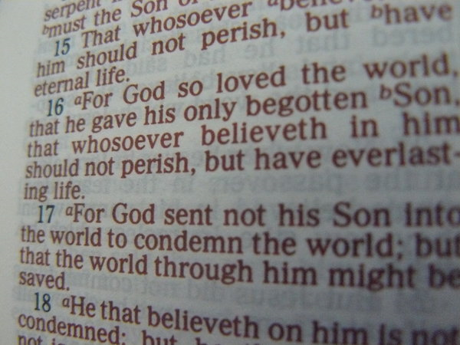

Slide 7
John 12:42
Nevertheless among the chief rulers also many believed on him; but because of the Pharisees they did not confess him, lest they should be put out of the synagogue:

Slide 8
John 12:43
For they loved the praise of men more than the praise of God.

Slide 9
John 12:44
Jesus cried and said, He that believeth on me, believeth not on me, but on him that sent me.

Slide 10
John 12:45
And he that seeth me seeth him that sent me.

Slide 11
John 12:46
I am come a light into the world, that whosoever believeth on me should not abide in darkness.

Slide 12
John 12:47
And if any man hear my words, and believe not, I judge him not: for I came not to judge the world, but to save the world.

Slide 13
John 12:48
He that rejecteth me, and receiveth not my words, hath one that judgeth him: the word that I have spoken, the same shall judge him in the last day.

Slide 14
John 12:49
For I have not spoken of myself; but the Father which sent me, he gave me a commandment, what I should say, and what I should speak.

Slide 15
John 12:50
And I know that his commandment is life everlasting: whatsoever I speak therefore, even as the Father said unto me, so I speak.

Slide 16
1 John 5:11
And this is the record, that God hath given to us eternal life, and this life is in his Son.

Slide 17
1 John 5:12
He that hath the Son hath life; and he that hath not the Son of God hath not life.

Slide 18
John 3:14
And as Moses lifted up the serpent in the wilderness, even so must the Son of man be lifted up:

Slide 19
John 3:15
That whosoever believeth in him should not perish, but have eternal life.

Slide 20
Numbers 21:4
And they journeyed from mount Hor by the way of the Red sea, to compass the land of Edom: and the soul of the people was much discouraged because of the way.

Slide 21
Numbers 21:5a
And the people spake against God, and against Moses, Wherefore have ye brought us up out of Egypt to die in the wilderness?

Slide 22
Numbers 21:5b
for there is no bread, neither is there any water; and our soul loatheth this light bread.

Slide 23
Numbers 21:6
And the LORD sent fiery serpents among the people, and they bit the people; and much people of Israel died.

Slide 24
Numbers 21:7a
Therefore the people came to Moses, and said, We have sinned, for we have spoken against the LORD, and against thee;

Slide 25
Numbers 21:7b
pray unto the LORD, that he take away the serpents from us. And Moses prayed for the people.

Slide 26
Numbers 21:8
And the LORD said unto Moses, Make thee a fiery serpent, and set it upon a pole: and it shall come to pass, that every one that is bitten, when he looketh upon it, shall live.

Slide 27
Numbers 21:9
And Moses made a serpent of brass, and put it upon a pole, and it came to pass, that if a serpent had bitten any man, when he beheld the serpent of brass, he lived.

Slide 28
Romans 6:23
For the wages of sin is death; but the gift of God is eternal life through Jesus Christ our Lord.

Slide 29
Revelation 12:9
And the great dragon was cast out, that old serpent, called the Devil, and Satan, which deceiveth the whole world: he was cast out into the earth, and his angels were cast out with him.

Slide 30
Revelation 20:2
And he laid hold on the dragon, that old serpent, which is the Devil, and Satan, and bound him a thousand years,

Slide 31
Hebrews 2:14
Forasmuch then as the children are partakers of flesh and blood, he also himself likewise took part of the same; that through death he might destroy him that had the power of death, that is, the devil;

Slide 32
Hebrews 2:15
And deliver them who through fear of death were all their lifetime subject to bondage.

Slide 33
Isaiah 53:1
Who hath believed our report? and to whom is the arm of the LORD revealed?

Slide 34
Isaiah 53:2
For he shall grow up before him as a tender plant, and as a root out of a dry ground: he hath no form nor comeliness; and when we shall see him, there is no beauty that we should desire him.

Slide 35
Isaiah 53:3
He is despised and rejected of men; a man of sorrows, and acquainted with grief: and we hid as it were our faces from him; he was despised, and we esteemed him not.

Slide 36
Isaiah 53:4
Surely he hath borne our griefs, and carried our sorrows: yet we did esteem him stricken, smitten of God, and afflicted.

Slide 37
Isaiah 53:5
But he was wounded for our transgressions, he was bruised for our iniquities: the chastisement of our peace was upon him; and with his stripes we are healed.

Slide 38
Genesis 3:14a
And the LORD God said unto the serpent, Because thou hast done this, thou art cursed above all cattle, and above every beast of the field;

Slide 39
Genesis 3:14b
upon thy belly shalt thou go, and dust shalt thou eat all the days of thy life:

Slide 40
Genesis 3:15
And I will put enmity between thee and the woman, and between thy seed and her seed; it shall bruise thy head, and thou shalt bruise his heel.

Slide 41
Galatians 3:13
Christ hath redeemed us from the curse of the law, being made a curse for us: for it is written, Cursed is every one that hangeth on a tree:

Slide 42
1 Peter 2:24
Who his own self bare our sins in his own body on the tree, that we, being dead to sins, should live unto righteousness: by whose stripes ye were healed.

Slide 43
2 Corinthians 5:21
For he hath made him to be sin for us, who knew no sin; that we might be made the righteousness of God in him.

Slide 44
John 3:15
That whosoever believeth in him should not perish, but have eternal life.

Slide 45
Faith in Christ Crucified!

Slide 46
John 3:16
For God so loved the world, that he gave his only begotten Son, that whosoever believeth in him should not perish, but have everlasting life.

Slide 47
John 3:17
For God sent not his Son into the world to condemn the world; but that the world through him might be saved.

Slide 48
The Magnitude of God’s Love—
He Gave His Only Begotten Son

Slide 49
The Reach of God’s Love—
He Gave it to a Sinful World

Slide 50
Romans 5:8
But God commendeth his love toward us, in that, while we were yet sinners, Christ died for us.

Slide 51
The Impartiality of God’s Love—
Whosoever Believeth!

Slide 52
Revelation 22:17
And the Spirit and the bride say, Come. And let him that heareth say, Come. And let him that is athirst come. And whosoever will, let him take the water of life freely.

Slide 53
The Beneficial Richness of God’s Love—
Everlasting Life!

Slide 54
The Limitation of God’s Love—
Unbelievers are Not Saved!

Slide 55
John 3:17
For God sent not his Son into the world to condemn the world; but that the world through him might be saved.

Slide 56
John 3:18
He that believeth on him is not condemned: but he that believeth not is condemned already, because he hath not believed in the name of the only begotten Son of God.

Slide 57
Isaiah 45:22
Look unto me, and be ye saved, all the ends of the earth: for I am God, and there is none else.

Slide 58
