Slide 1
The New Birth Explained
John 3:1-8
May 23-24, 2015
Calvary Chapel of El Paso

Slide 2
John 3:1
There was a man of the Pharisees, named Nicodemus, a ruler of the Jews:

Slide 3
John 3:2
The same came to Jesus by night, and said unto him, Rabbi, we know that thou art a teacher come from God: for no man can do these miracles that thou doest, except God be with him.

Slide 4
John 3:3
Jesus answered and said unto him, Verily, verily, I say unto thee, Except a man be born again, he cannot see the kingdom of God.

Slide 5
John 3:4
Nicodemus saith unto him, How can a man be born when he is old? can he enter the second time into his mother's womb, and be born?

Slide 6
John 3:5
Jesus answered, Verily, verily, I say unto thee, Except a man be born of water and of the Spirit, he cannot enter into the kingdom of God.

Slide 7
John 3:6
That which is born of the flesh is flesh; and that which is born of the Spirit is spirit.

Slide 8
John 3:7
Marvel not that I said unto thee, Ye must be born again.

Slide 9
John 3:8
The wind bloweth where it listeth, and thou hearest the sound thereof, but canst not tell whence it cometh, and whither it goeth: so is every one that is born of the Spirit.

Slide 10
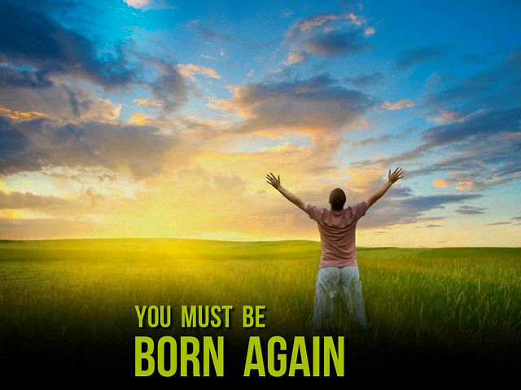

Slide 11
John 2:21
But he spake of the temple of his body.

Slide 12
John 2:22
When therefore he was risen from the dead, his disciples remembered that he had said this unto them; and they believed the scripture, and the word which Jesus had said.

Slide 13
John 2:23
Now when he was in Jerusalem at the passover, in the feast day, many believed in his name, when they saw the miracles which he did.

Slide 14
John 2:24
But Jesus did not commit himself unto them, because he knew all men,

Slide 15
John 2:25
And needed not that any should testify of man: for he knew what was in man.

Slide 16
Answers! Isn’t That What We All Want?

Slide 17
John 3:1
There was a man of the Pharisees, named Nicodemus, a ruler of the Jews:

Slide 18
John 3:2
The same came to Jesus by night, and said unto him, Rabbi, we know that thou art a teacher come from God: for no man can do these miracles that thou doest, except God be with him.

Slide 19
Isaiah 55:6
Seek ye the LORD while he may be found, call ye upon him while he is near:

Slide 20
Jeremiah 29:13
And ye shall seek me, and find me, when ye shall search for me with all your heart.

Slide 21
John 3:2
The same came to Jesus by night, and said unto him, Rabbi, we know that thou art a teacher come from God: for no man can do these miracles that thou doest, except God be with him.

Slide 22
John 3:3
Jesus answered and said unto him, Verily, verily, I say unto thee, Except a man be born again, he cannot see the kingdom of God.

Slide 23
John 3:4
Nicodemus saith unto him, How can a man be born when he is old? can he enter the second time into his mother's womb, and be born?

Slide 24
John 3:5
Jesus answered, Verily, verily, I say unto thee, Except a man be born of water and of the Spirit, he cannot enter into the kingdom of God.

Slide 25
John 3:6
That which is born of the flesh is flesh; and that which is born of the Spirit is spirit.

Slide 26
John 3:7
Marvel not that I said unto thee, Ye must be born again.

Slide 27
John 3:8
The wind bloweth where it listeth, and thou hearest the sound thereof, but canst not tell whence it cometh, and whither it goeth: so is every one that is born of the Spirit.

Slide 28
Answer: You Need To Be Born Again!

Slide 29
Isaiah 64:6
But we are all as an unclean thing, and all our righteousnesses are as filthy rags; and we all do fade as a leaf; and our iniquities, like the wind, have taken us away.

Slide 30
John 3:16
For God so loved the world, that he gave his only begotten Son, that whosoever believeth in him should not perish, but have everlasting life.

Slide 31
John 3:36
He that believeth on the Son hath everlasting life: and he that believeth not the Son shall not see life; but the wrath of God abideth on him.

Slide 32
Ephesians 2:8
For by grace are ye saved through faith; and that not of yourselves: it is the gift of God:

Slide 33
Ephesians 2:9
Not of works, lest any man should boast.

Slide 34
Titus 3:5
Not by works of righteousness which we have done, but according to his mercy he saved us, by the washing of regeneration, and renewing of the Holy Ghost;

Slide 35
Ephesians 5:25
Husbands, love your wives, even as Christ also loved the church, and gave himself for it;

Slide 36
Ephesians 5:26
That he might sanctify and cleanse it with the washing of water by the word,

Slide 37
John 7:37
In the last day, that great day of the feast, Jesus stood and cried, saying, If any man thirst, let him come unto me, and drink.

Slide 38
John 7:38
He that believeth on me, as the scripture hath said, out of his belly shall flow rivers of living water.

Slide 39
John 7:39
(But this spake he of the Spirit, which they that believe on him should receive: for the Holy Ghost was not yet given; because that Jesus was not yet glorified.)

Slide 40
Matthew 3:1
In those days came John the Baptist, preaching in the wilderness of Judaea,

Slide 41
Matthew 3:2
And saying, Repent ye: for the kingdom of heaven is at hand.

Slide 42
Matthew 3:3
For this is he that was spoken of by the prophet Esaias, saying, The voice of one crying in the wilderness, Prepare ye the way of the Lord, make his paths straight.

Slide 43
Matthew 3:4
And the same John had his raiment of camel's hair, and a leathern girdle about his loins; and his meat was locusts and wild honey.

Slide 44
Matthew 3:5
Then went out to him Jerusalem, and all Judaea, and all the region round about Jordan,

Slide 45
Matthew 3:6
And were baptized of him in Jordan, confessing their sins.

Slide 46
John 1:12
But as many as received him, to them gave he power to become the sons of God, even to them that believe on his name:

Slide 47
John 1:13
Which were born, not of blood, nor of the will of the flesh, nor of the will of man, but of God.

