Slide 1
He Must Increase!
John 3:22-36
July 18-19, 2015
Calvary Chapel of El Paso

Slide 2
John 3:22
After these things came Jesus and his disciples into the land of Judaea; and there he tarried with them, and baptized.

Slide 3
John 3:23
And John also was baptizing in Aenon near to Salim, because there was much water there: and they came, and were baptized.

Slide 4
John 3:24
For John was not yet cast into prison.

Slide 5
John 3:25
Then there arose a question between some of John's disciples and the Jews about purifying.

Slide 6
John 3:26
And they came unto John, and said unto him, Rabbi, he that was with thee beyond Jordan, to whom thou barest witness, behold, the same baptizeth, and all men come to him.

Slide 7
John 3:27
John answered and said, A man can receive nothing, except it be given him from heaven.

Slide 8
John 3:28
Ye yourselves bear me witness, that I said, I am not the Christ, but that I am sent before him.

Slide 9
John 3:29
He that hath the bride is the bridegroom: but the friend of the bridegroom, which standeth and heareth him, rejoiceth greatly because of the bridegroom's voice: this my joy therefore is fulfilled.

Slide 10
John 3:30
He must increase, but I must decrease.

Slide 11
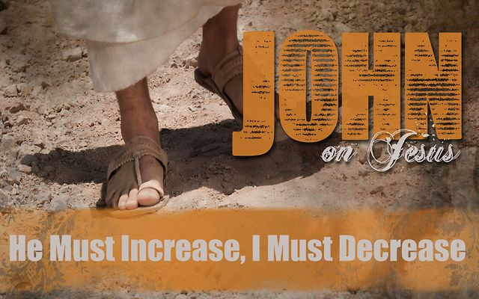

Slide 12
John 3:25
Then there arose a question between some of John's disciples and the Jews about purifying.

Slide 13
John 3:26
And they came unto John, and said unto him, Rabbi, he that was with thee beyond Jordan, to whom thou barest witness, behold, the same baptizeth, and all men come to him.

Slide 14
Luke 16:13
No servant can serve two masters: for either he will hate the one, and love the other; or else he will hold to the one, and despise the other. Ye cannot serve God and mammon.

Slide 15
Romans 6:16
Know ye not, that to whom ye yield yourselves servants to obey, his servants ye are to whom ye obey; whether of sin unto death, or of obedience unto righteousness?

Slide 16
John 3:27
John answered and said, A man can receive nothing, except it be given him from heaven.

Slide 17
John 3:28
Ye yourselves bear me witness, that I said, I am not the Christ, but that I am sent before him.

Slide 18
John 3:29
He that hath the bride is the bridegroom: but the friend of the bridegroom, which standeth and heareth him, rejoiceth greatly because of the bridegroom's voice: this my joy therefore is fulfilled.

Slide 19
John 3:30
He must increase, but I must decrease.

Slide 20
Look at the Big Picture!

Slide 21
James 1:17
Every good gift and every perfect gift is from above, and cometh down from the Father of lights, with whom is no variableness, neither shadow of turning.

Slide 22
Be Secure in Who You Are In Christ!

Slide 23
John 15:16
Ye have not chosen me, but I have chosen you, and ordained you, that ye should go and bring forth fruit, and that your fruit should remain: that whatsoever ye shall ask of the Father in my name, he may give it you.

Slide 24
Have Joy to the Full!

Slide 25
John 3:29
He that hath the bride is the bridegroom: but the friend of the bridegroom, which standeth and heareth him, rejoiceth greatly because of the bridegroom's voice: this my joy therefore is fulfilled.

Slide 26
Have Pure Humility!

Slide 27
John 3:30
He must increase, but I must decrease.

Slide 28
John 3:31
He that cometh from above is above all: he that is of the earth is earthly, and speaketh of the earth: he that cometh from heaven is above all.

Slide 29
John 3:32
And what he hath seen and heard, that he testifieth; and no man receiveth his testimony.

Slide 30
John 3:33
He that hath received his testimony hath set to his seal that God is true.

Slide 31
John 3:34
For he whom God hath sent speaketh the words of God: for God giveth not the Spirit by measure unto him.

Slide 32
John 3:35
The Father loveth the Son, and hath given all things into his hand.

Slide 33
John 3:36
He that believeth on the Son hath everlasting life: and he that believeth not the Son shall not see life; but the wrath of God abideth on him.

Slide 34
Hebrews 9:11
But Christ being come an high priest of good things to come, by a greater and more perfect tabernacle, not made with hands, that is to say, not of this building;

Slide 35
Hebrews 9:12
Neither by the blood of goats and calves, but by his own blood he entered in once into the holy place, having obtained eternal redemption for us.

Slide 36
Hebrews 9:13
For if the blood of bulls and of goats, and the ashes of an heifer sprinkling the unclean, sanctifieth to the purifying of the flesh:

Slide 37
Hebrews 9:14
How much more shall the blood of Christ, who through the eternal Spirit offered himself without spot to God, purge your conscience from dead works to serve the living God?

Slide 38
Hebrews 9:15a
And for this cause he is the mediator of the new testament, that by means of death, for the redemption of the transgressions that were under the first testament,

Slide 39
Hebrews 9:15b
they which are called might receive the promise of eternal inheritance.

Slide 40
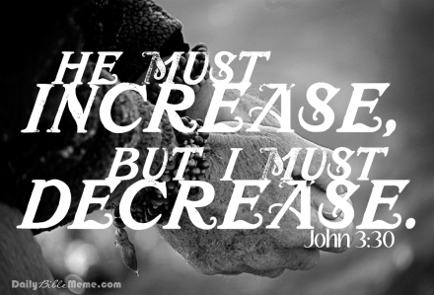
XXXXXXXXXXXXXX

