Slide 1
Isaac: Facing Trials and Temptations, Part 2
Genesis 26:12-35
March 23-24, 2013
Calvary Chapel of El Paso

Slide 2
Genesis 26:12
Then Isaac sowed in that land, and reaped in the same year a hundredfold; and the LORD blessed him.

Slide 3
Genesis 26:13
The man began to prosper, and continued prospering until he became very prosperous;

Slide 4
Genesis 26:14
for he had possessions of flocks and possessions of herds and a great number of servants. So the Philistines envied him.

Slide 5
Genesis 26:15
Now the Philistines had stopped up all the wells which his father's servants had dug in the days of Abraham his father, and they had filled them with earth.

Slide 6
Genesis 26:16
And Abimelech said to Isaac, "Go away from us, for you are much mightier than we."

Slide 7
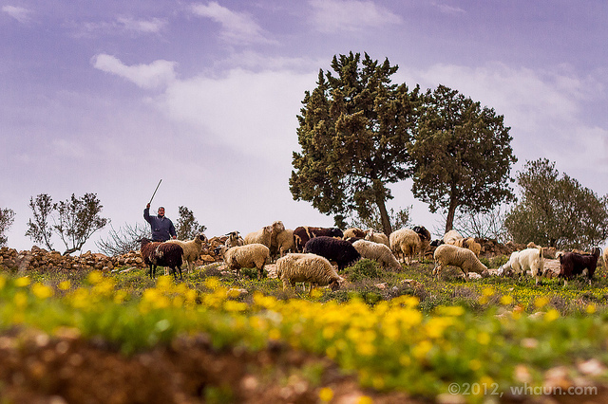

Slide 8
Trials and Temptations
James 1:2-4
James 1:12-15

Slide 9
A Faith That Can’t Be Tested Can’t Be Trusted!
The Lord tests us to bring out the best in us!
Satan tempts us to bring out the worst in us!

Slide 10
Genesis 26:12-14
¹² Then Isaac sowed in that land, and reaped in the same year a hundredfold; and the LORD blessed him. ¹³ The man began to prosper, and continued prospering until he became very prosperous; ¹⁴ for he had possessions of flocks and possessions of herds and a great number of servants. So the Philistines envied him.

Slide 11
TRIAL THREE—FACING ENVY AND REJECTION DUE TO PROSPERITY

Slide 12
Isaac Endeavored for God’s Favor
Isaac Received an Enrichment of God’s Favor

Slide 13
2 Timothy 2:11-13
¹¹ This is a faithful saying: For if we died with Him, We shall also live with Him. ¹² If we endure, We shall also reign with Him. If we deny Him, He also will deny us. ¹³ If we are faithless, He remains faithful; He cannot deny Himself.

Slide 14
Genesis 26:5
because Abraham obeyed My voice and kept My charge, My commandments, My statutes, and My laws."

Slide 15
Genesis 26:14-17
¹⁴ for he had possessions of flocks and possessions of herds and a great number of servants. So the Philistines envied him. ¹⁵ Now the Philistines had stopped up all the wells which his father's servants had dug in the days of Abraham his father, and they had filled them with earth. ¹⁶ And Abimelech said to Isaac, "Go away from us, for you are much mightier than we." ¹⁷ Then Isaac departed from there and pitched his tent in the Valley of Gerar, and dwelt there.

Slide 16
Envy Leads to Enmity (Hostility)

Slide 17
2 Thessalonians 3:10-12
¹⁰ For even when we were with you, we commanded you this: If anyone will not work, neither shall he eat. ¹¹ For we hear that there are some who walk among you in a disorderly manner, not working at all, but are busybodies. ¹² Now those who are such we command and exhort through our Lord Jesus Christ that they work in quietness and eat their own bread.

Slide 18
2 Chronicles 25:2
And he did what was right in the sight of the LORD, but not with a loyal (perfect) heart.

Slide 19
James 1:6-8
⁶ But let him ask in faith, with no doubting, for he who doubts is like a wave of the sea driven and tossed by the wind. ⁷ For let not that man suppose that he will receive anything from the Lord; ⁸ he is a double-minded man, unstable in all his ways.

Slide 20
James 4:8
⁸ Draw near to God and He will draw near to you. Cleanse your hands, you sinners; and purify your hearts, you double-minded.

Slide 21
TRIAL FOUR—FACING STRIFE AND HOSTILITY

Slide 22
Genesis 26:18-22

Slide 23
Job 5:17-18
¹⁷ Behold, happy is the man whom God corrects; Therefore do not despise the chastening of the Almighty. ¹⁸ For He bruises, but He binds up; He wounds, but His hands make whole.

Slide 24
Job 23:10
But He knows the way that I take; When He has tested me, I shall come forth as gold.

Slide 25
2 Corinthians 4:16-18
¹⁶ Therefore we do not lose heart. Even though our outward man is perishing, yet the inward man is being renewed day by day. ¹⁷ For our light affliction, which is but for a moment, is working for us a far more exceeding and eternal weight of glory, ¹⁸ while we do not look at the things which are seen, but at the things which are not seen. For the things which are seen are temporary, but the things which are not seen are eternal.

Slide 26
TRIAL FIVE—FACING FEAR AND THE FAILURE OF GOD’S PROMISES

Slide 27
Genesis 26:23-25
²³ Then he went up from there to Beersheba. ²⁴ And the LORD appeared to him the same night and said, "I am the God of your father Abraham; do not fear, for I am with you. I will bless you and multiply your descendants for My servant Abraham's sake." ²⁵ So he built an altar there and called on the name of the LORD, and he pitched his tent there; and there Isaac's servants dug a well.

Slide 28
Acts 18:9-10
⁹ Now the Lord spoke to Paul in the night by a vision, "Do not be afraid, but speak, and do not keep silent; ¹⁰ for I am with you, and no one will attack you to hurt you; for I have many people in this city."

Slide 29
Acts 23:11
¹¹ But the following night the Lord stood by him and said, "Be of good cheer, Paul; for as you have testified for Me in Jerusalem, so you must also bear witness at Rome."

Slide 30
Romans 8:31
What then shall we say to these things? If God is for us, who can be against us?

Slide 31
Romans 8:37-39
³⁷ Yet in all these things we are more than conquerors through Him who loved us. ³⁸ For I am persuaded that neither death nor life, nor angels nor principalities nor powers, nor things present nor things to come, ³⁹ nor height nor depth, nor any other created thing, shall be able to separate us from the love of God which is in Christ Jesus our Lord.

Slide 32
Deuteronomy 31:6
Be strong and of good courage, do not fear nor be afraid of them; for the LORD your God, He is the One who goes with you. He will not leave you nor forsake you."

Slide 33
TRIAL SIX—FACING THE NEED TO BUILD GOOD RELATIONSHIPS

Slide 34
Genesis 26:26-35

Slide 35
Matthew 5:9
Blessed are the peacemakers, For they shall be called sons of God.

Slide 36
Matthew 5:43-45
⁴³ "You have heard that it was said, 'You shall love your neighbor and hate your enemy.' ⁴⁴ But I say to you, love your enemies, bless those who curse you, do good to those who hate you, and pray for those who spitefully use you and persecute you, ⁴⁵ that you may be sons of your Father in heaven; for He makes His sun rise on the evil and on the good, and sends rain on the just and on the unjust.

Slide 37
Romans 12:18
If it is possible, as much as depends on you, live peaceably with all men.

Slide 38
Romans 14:19
Therefore let us pursue the things which make for peace and the things by which one may edify another.

Slide 39
Hebrews 12:14
Pursue peace with all people, and holiness, without which no one will see the Lord:

Slide 40
Psalm 4:1
Hear me when I call, O God of my righteousness: thou hast enlarged me when I was in distress; have mercy upon me, and hear my prayer.

Slide 41
Psalm 25:17
The troubles of my heart have enlarged; Bring me out of my distresses!

Slide 42
Psalm 18:19
He also brought me out into a broad place; He delivered me because He delighted in me.

