Slide 1
Introduction to the Feasts of Israel
Leviticus 23
August 19, 2015
Calvary Chapel of El Paso

Slide 2
Leviticus 23:1
And the LORD spake unto Moses, saying,

Slide 3
Leviticus 23:2
Speak unto the children of Israel, and say unto them, Concerning the feasts of the LORD, which ye shall proclaim to be holy convocations, even these are my feasts.

Slide 4
Leviticus 23:3
Six days shall work be done: but the seventh day is the sabbath of rest, an holy convocation; ye shall do no work therein: it is the sabbath of the LORD in all your dwellings.

Slide 5
Leviticus 23:4
These are the feasts of the LORD, even holy convocations, which ye shall proclaim in their seasons.

Slide 6
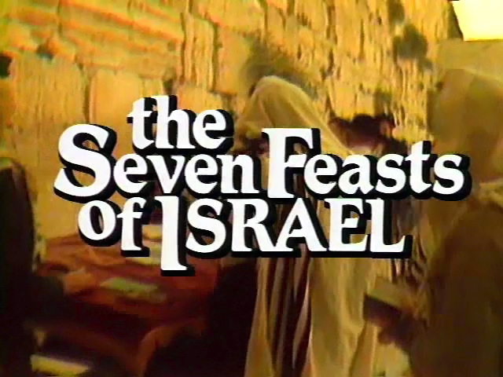

Slide 7
Colossians 2:16
Let no man therefore judge you in meat, or in drink, or in respect of an holyday, or of the new moon, or of the sabbath days:

Slide 8
Colossians 2:17
Which are a shadow of things to come; but the body (substance) is of (belongs to) Christ.

Slide 9
Exodus 23:14
Three times thou shalt keep a feast unto me in the year.

Slide 10
Exodus 23:15a
Thou shalt keep the feast of unleavened bread: (thou shalt eat unleavened bread seven days, as I commanded thee, in the time appointed of the month Abib;

Slide 11
Exodus 23:15b
for in it thou camest out from Egypt: and none shall appear before me empty:)

Slide 12
Exodus 23:16
And the feast of harvest, the firstfruits of thy labours, which thou hast sown in the field: and the feast of ingathering, which is in the end of the year, when thou hast gathered in thy labours out of the field.

Slide 13
Exodus 23:17
Three times in the year all thy males shall appear before the Lord GOD.

Slide 14
Passover
(Pesach)
Nisan 14-15

Slide 15
Unleavened Bread (Chag HaMatzot)
Nisan 15-22

Slide 16
First Fruits
(Yom HaBikkurim)
Nisan 16-17

Slide 17
Pentecost (Shavu’ot)
Sivan 6-7

Slide 18
Trumpets
(Yom Teru’ah)
Tishri 1

Slide 19
Day of Atonement
(Yom Kippur)
Tishri 10

Slide 20
Tabernacles (Sukkot)
Tishri 15-22

Slide 21
1 Corinthians 15:20
But now is Christ risen from the dead, and become the firstfruits of them that slept.

Slide 22
Romans 16:25
Now to him that is of power to stablish you according to my gospel, and the preaching of Jesus Christ, according to the revelation of the mystery, which was kept secret since the world began,

Slide 23
Romans 16:26
But now is made manifest, and by the scriptures of the prophets, according to the commandment of the everlasting God, made known to all nations for the obedience of faith:

Slide 24
1 Thessalonians 4:16
For the Lord himself shall descend from heaven with a shout, with the voice of the archangel, and with the trump of God: and the dead in Christ shall rise first:

Slide 25
1 Thessalonians 4:17
Then we which are alive and remain shall be caught up together with them in the clouds, to meet the Lord in the air: and so shall we ever be with the Lord.

Slide 26
1 Corinthians 15:51
Behold, I shew you a mystery; We shall not all sleep, but we shall all be changed,

Slide 27
1 Corinthians 15:52
In a moment, in the twinkling of an eye, at the last trump: for the trumpet shall sound, and the dead shall be raised incorruptible, and we shall be changed.

Slide 28
Zechariah 12:9
And it shall come to pass in that day, that I will seek to destroy all the nations that come against Jerusalem.

Slide 29
Zechariah 12:10a
And I will pour upon the house of David, and upon the inhabitants of Jerusalem, the spirit of grace and of supplications:

Slide 30
Zechariah 12:10b
and they shall look upon me whom they have pierced, and they shall mourn for him, as one mourneth for his only son, and shall be in bitterness for him, as one that is in bitterness for his firstborn.

Slide 31
Romans 11:25
For I would not, brethren, that ye should be ignorant of this mystery, lest ye should be wise in your own conceits; that blindness in part is happened to Israel, until the fulness of the Gentiles be come in.

Slide 32
Romans 11:26
And so all Israel shall be saved: as it is written, There shall come out of Sion the Deliverer, and shall turn away ungodliness from Jacob:

Slide 33
Romans 11:27
For this is my covenant unto them, when I shall take away their sins.

Slide 34
Micah 4:2a
And many nations shall come, and say, Come, and let us go up to the mountain of the LORD, and to the house of the God of Jacob;

Slide 35
Micah 4:2b
and he will teach us of his ways, and we will walk in his paths: for the law shall go forth of Zion, and the word of the LORD from Jerusalem.

Slide 36
Leviticus 23:2
Speak unto the children of Israel, and say unto them, Concerning the feasts of the LORD, which ye shall proclaim to be holy convocations, even these are my feasts.

Slide 37
Feasts:
Mo-ed; מוֹעֵד
An appointment; a fixed time or season

Slide 38
Convocation:
Miqra; מִקְרָא.
An assembly or gathering

Slide 39
Leviticus 23:3
Six days shall work be done: but the seventh day is the sabbath of rest, an holy convocation; ye shall do no work therein: it is the sabbath of the LORD in all your dwellings.

Slide 40
Hebrews 4:8
For if Jesus had given them rest, then would he not afterward have spoken of another day.

Slide 41
Hebrews 4:9
There remaineth therefore a rest to the people of God.

Slide 42
Hebrews 4:10
For he that is entered into his rest, he also hath ceased from his own works, as God did from his.

Slide 43
Hebrews 4:11
Let us labour therefore to enter into that rest, lest any man fall after the same example of unbelief.

