Slide 1
How to live in the light of Christ’s return
1 Thessalonians 5
November 1-2, 2014
Calvary Chapel of El Paso

Slide 2
1 Thessalonians 5:1
But of the times and the seasons, brethren, ye have no need that I write unto you.

Slide 3
1 Thessalonians 5:2
For yourselves know perfectly that the day of the Lord so cometh as a thief in the night.

Slide 4
1 Thessalonians 5:3
For when they shall say, Peace and safety; then sudden destruction cometh upon them, as travail upon a woman with child; and they shall not escape.

Slide 5
1 Thessalonians 5:4
But ye, brethren, are not in darkness, that that day should overtake you as a thief.

Slide 6
1 Thessalonians 5:5
Ye are all the children of light, and the children of the day: we are not of the night, nor of darkness.

Slide 7
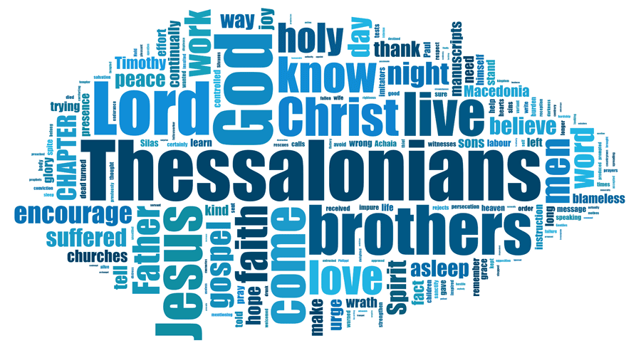

Slide 8
1 Thessalonians 5:1
But of the times and the seasons, brethren, ye have no need that I write unto you.

Slide 9
1 Thessalonians 5:2
For yourselves know perfectly that the day of the Lord so cometh as a thief in the night.

Slide 10
[Consider this: over the past 5+ millennia, man has had his “day”; soon the LORD will have HIS day!]

Slide 11
Isaiah 13:6
Howl ye; for the day of the LORD is at hand; it shall come as a destruction from the Almighty.

Slide 12
Isaiah 13:9
Behold, the day of the LORD cometh, cruel both with wrath and fierce anger, to lay the land desolate: and he shall destroy the sinners thereof out of it.

Slide 13
Joel 1:15
Alas for the day! for the day of the LORD is at hand, and as a destruction from the Almighty shall it come.

Slide 14
1 Thessalonians 5:3
For when they shall say, Peace and safety; then sudden destruction cometh upon them, as travail upon a woman with child; and they shall not escape.

Slide 15
Revelation 6:15a
And the kings of the earth, and the great men, and the rich men, and the chief captains, and the mighty men, and every bondman,

Slide 16
Revelation 6:15b
…and every free man, hid themselves in the dens and in the rocks of the mountains;

Slide 17
Revelation 6:16
And said to the mountains and rocks, Fall on us, and hide us from the face of him that sitteth on the throne, and from the wrath of the Lamb:

Slide 18
Revelation 6:17
For the great day of his wrath is come; and who shall be able to stand?

Slide 19
1 Thessalonians 5:4
But ye, brethren, are not in darkness, that that day should overtake you as a thief.

Slide 20
1 Thessalonians 5:5
Ye are all the children of light, and the children of the day: we are not of the night, nor of darkness.

Slide 21
1 Peter 4:7
But the end of all things is at hand: be ye therefore sober, and watch unto prayer.

Slide 22
Ephesians 5:14
Wherefore he saith, Awake thou that sleepest, and arise from the dead, and Christ shall give thee light.

Slide 23
Ephesians 5:15
See then that ye walk circumspectly, not as fools, but as wise,

Slide 24
Ephesians 5:16
Redeeming the time, because the days are evil.

Slide 25
1 Thessalonians 5:6
Therefore let us not sleep, as do others; but let us watch and be sober.

Slide 26
1 Thessalonians 5:7
For they that sleep sleep in the night; and they that be drunken are drunken in the night.

Slide 27
1 Thessalonians 5:8
But let us, who are of the day, be sober, putting on the breastplate of faith and love; and for an helmet, the hope of salvation.

Slide 28
1 Thessalonians 5:9
For God hath not appointed us to wrath, but to obtain salvation by our Lord Jesus Christ,

Slide 29
1 Thessalonians 5:10
Who died for us, that, whether we wake or sleep, we should live together with him.

Slide 30
John 3:19
And this is the condemnation, that light is come into the world, and men loved darkness rather than light, because their deeds were evil.

Slide 31
John 3:20
For every one that doeth evil hateth the light, neither cometh to the light, lest his deeds should be reproved.

Slide 32
John 3:21
But he that doeth truth cometh to the light, that his deeds may be made manifest, that they are wrought in God.

Slide 33
1 Thessalonians 5:11
Wherefore comfort yourselves together, and edify one another, even as also ye do.

Slide 34
Luke 21:34
And take heed to yourselves, lest at any time your hearts be overcharged with surfeiting, and drunkenness, and cares of this life, and so that day come upon you unawares.

Slide 35
Luke 21:35
For as a snare shall it come on all them that dwell on the face of the whole earth.

Slide 36
Luke 21:36
Watch ye therefore, and pray always, that ye may be accounted worthy to escape all these things that shall come to pass, and to stand before the Son of man.

Slide 37
1 Thessalonians 5:12
And we beseech you, brethren, to know them which labour among you, and are over you in the Lord, and admonish you;

Slide 38
1 Thessalonians 5:13
And to esteem them very highly in love for their work's sake. And be at peace among yourselves.

Slide 39
1 Thessalonians 5:14
Now we exhort you, brethren, warn them that are unruly, comfort the feebleminded, support the weak, be patient toward all men.

Slide 40
1 Thessalonians 5:15
See that none render evil for evil unto any man; but ever follow that which is good, both among yourselves, and to all men.

Slide 41
Galatians 6:1
Brethren, if a man be overtaken in a fault, ye which are spiritual, restore such an one in the spirit of meekness; considering thyself, lest thou also be tempted.

Slide 42
Galatians 6:2
Bear ye one another's burdens, and so fulfil the law of Christ.

Slide 43
Galatians 6:3
For if a man think himself to be something, when he is nothing, he deceiveth himself.

Slide 44
Galatians 6:4
But let every man prove his own work, and then shall he have rejoicing in himself alone, and not in another.

Slide 45
Galatians 6:5
For every man shall bear his own burden.

Slide 46
1 Thessalonians 5:16
Rejoice evermore.

Slide 47
1 Thessalonians 5:17
Pray without ceasing.

Slide 48
1 Thessalonians 5:18
In every thing give thanks: for this is the will of God in Christ Jesus concerning you.

Slide 49
1 Thessalonians 5:19
Quench not the Spirit.

Slide 50
1 Thessalonians 5:20
Despise not prophesyings.

Slide 51
1 Thessalonians 5:21
Prove all things; hold fast that which is good.

Slide 52
1 Thessalonians 5:22
Abstain from all appearance of evil.

Slide 53
1 Thessalonians 5:23
And the very God of peace sanctify you wholly; and I pray God your whole spirit and soul and body be preserved blameless unto the coming of our Lord Jesus Christ.

Slide 54
1 Thessalonians 5:24
Faithful is he that calleth you, who also will do it.

Slide 55
1 Thessalonians 5:25
Brethren, pray for us.

Slide 56
1 Thessalonians 5:26
Greet all the brethren with an holy kiss.

Slide 57
1 Thessalonians 5:27
I charge you by the Lord that this epistle be read unto all the holy brethren.

Slide 58
1 Thessalonians 5:28
The grace of our Lord Jesus Christ be with you. Amen.

Slide 59
