Slide 1
Do ALL Things Without…
Philippians 2:12-16
Calvary Chapel of El Paso

Slide 2
Philippians 2:12
Wherefore, my beloved, as ye have always obeyed, not as in my presence only, but now much more in my absence, work out your own salvation with fear and trembling.

Slide 3
Philippians 2:13
For it is God which worketh in you both to will and to do of his good pleasure.

Slide 4
Philippians 2:14
Do all things without murmurings and disputings:

Slide 5
Philippians 2:15
That ye may be blameless and harmless, the sons of God, without rebuke, in the midst of a crooked and perverse nation, among whom ye shine as lights in the world;

Slide 6
Philippians 2:16
Holding forth the word of life; that I may rejoice in the day of Christ, that I have not run in vain, neither laboured in vain.

Slide 8
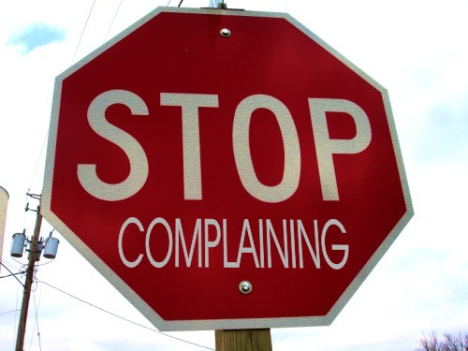

Slide 9
Song of Songs 5:16
His mouth is most sweet: yea, he is altogether lovely. This is my beloved, and this is my friend, O daughters of Jerusalem.

Slide 10
1 Peter 1:6
Wherein ye greatly rejoice, though now for a season, if need be, ye are in heaviness through manifold temptations:

Slide 11
1 Peter 1:7
That the trial of your faith, being much more precious than of gold that perisheth, though it be tried with fire, might be found unto praise and honour and glory at the appearing of Jesus Christ:

Slide 12
1 Peter 1:8
Whom having not seen, ye love; in whom, though now ye see him not, yet believing, ye rejoice with joy unspeakable and full of glory:

Slide 13
Ephesians 5:1
Be ye therefore followers (imitators) of God, as dear children;

Slide 14
Ephesians 5:2
And walk in love, as Christ also hath loved us, and hath given himself for us an offering and a sacrifice to God for a sweetsmelling savour.

Slide 15
Matthew 5:14
Ye are the light of the world. A city that is set on an hill cannot be hid.

Slide 16
Matthew 5:15
Neither do men light a candle, and put it under a bushel, but on a candlestick; and it giveth light unto all that are in the house.

Slide 17
Matthew 5:16
Let your light so shine before men, that they may see your good works, and glorify your Father which is in heaven.

Slide 18
Romans 1:21
Because that, when they knew God, they glorified him not as God, neither were thankful; but became vain in their imaginations, and their foolish heart was darkened.

Slide 19
Colossians 3:15
And let the peace of God rule in your hearts, to the which also ye are called in one body; and be ye thankful.

Slide 20
1 Thessalonians 5:18
In every thing give thanks: for this is the will of God in Christ Jesus concerning you.

Slide 21
Philippians 2:13
For it is God which worketh in you both to will and to do of his good pleasure.

Slide 22
Philippians 1:6
Being confident of this very thing, that he which hath begun a good work in you will perform it until the day of Jesus Christ:

Slide 23
Ephesians 2:10
For we are HIS workmanship, created in Christ Jesus unto good works, which God hath before ordained that we should walk in them.

Slide 24
Romans 8:28
And we know that all things work together for good to them that love God, to them who are the called according to his purpose.

Slide 25
Romans 8:29
For whom he did foreknow, he also did predestinate to be conformed to the image of his Son, that he might be the firstborn among many brethren.

Slide 26
Romans 8:30
Moreover whom he did predestinate, them he also called: and whom he called, them he also justified: and whom he justified, them he also glorified.

Slide 27
Galatians 5:22
But the fruit of the Spirit is love, joy, peace, longsuffering, gentleness, goodness, faith,

Slide 28
Galatians 5:23
Meekness, temperance (self-control): against such there is no law.

Slide 29
Galatians 5:24
And they that are Christ's have crucified the flesh with the affections and lusts.

Slide 30
Galatians 5:25
If we live in the Spirit, let us also walk in the Spirit.

Slide 31
Galatians 5:26
Let us not be desirous of vain glory, provoking one another, envying one another.

Slide 32
Colossians 3:1
If ye then be risen with Christ, seek those things which are above, where Christ sitteth on the right hand of God.

Slide 33
Colossians 3:2
Set your affection on things above, not on things on the earth.

Slide 34
Colossians 3:3
For ye are dead, and your life is hid with Christ in God.

Slide 35
Colossians 3:4
When Christ, who is our life, shall appear, then shall ye also appear with him in glory.

Slide 36
Philippians 2:14
Do all things without murmurings and disputings:

Slide 37
Philippians 2:15
That ye may be blameless and harmless, the sons of God, without rebuke, in the midst of a crooked and perverse nation, among whom ye shine as lights in the world;

Slide 38
Philippians 2:12
Wherefore, my beloved, as ye have always obeyed, not as in my presence only, but now much more in my absence, work out your own salvation with fear and trembling.

Slide 39
Be Blameless

Slide 40
Be Harmless

Slide 41
Be Children of God

Slide 42
Deuteronomy 1:26
Notwithstanding ye would not go up, but rebelled against the commandment of the LORD your God:

Slide 43
Deuteronomy 1:27
And ye murmured in your tents, and said, Because the LORD hated us, he hath brought us forth out of the land of Egypt, to deliver us into the hand of the Amorites, to destroy us.

Slide 44
Philippians 2:16
Holding forth the word of life; that I may rejoice in the day of Christ, that I have not run in vain, neither laboured in vain.

Slide 45
