Slide 1
Daniel 8:9-12
Wednesday,
April 15, 2015
Calvary Chapel of El Paso

Slide 2
Daniel 8:4
I saw the ram pushing westward, and northward, and southward; so that no beasts might stand before him, neither was there any that could deliver out of his hand; but he did according to his will, and became great.

Slide 3
Daniel 8:5
And as I was considering, behold, an he goat came from the west on the face of the whole earth, and touched not the ground: and the goat had a notable horn between his eyes.

Slide 4
Daniel 8:6
And he came to the ram that had two horns, which I had seen standing before the river, and ran unto him in the fury of his power.

Slide 5
Daniel 8:7a
And I saw him come close unto the ram, and he was moved with choler against him, and smote the ram, and brake his two horns: and there was no power in the ram to stand before him,

Slide 6
Daniel 8:7b
but he cast him down to the ground, and stamped upon him: and there was none that could deliver the ram out of his hand.

Slide 7
Daniel 8:8
Therefore the he goat waxed very great: and when he was strong, the great horn was broken; and for it came up four notable ones toward the four winds of heaven.

Slide 8
Daniel 8:9
And out of one of them came forth a little horn, which waxed exceeding great, toward the south, and toward the east, and toward the pleasant land.

Slide 9
Daniel 8:10
And it waxed great, even to the host of heaven; and it cast down some of the host and of the stars to the ground, and stamped upon them.

Slide 10
Daniel 8:11
Yea, he magnified himself even to the prince of the host, and by him the daily sacrifice was taken away, and the place of his sanctuary was cast down.

Slide 11
Daniel 8:12
And an host was given him against the daily sacrifice by reason of transgression, and it cast down the truth to the ground; and it practised, and prospered.

Slide 13
Daniel 8:5
And as I was considering, behold, an he goat came from the west on the face of the whole earth, and touched not the ground: and the goat had a notable horn between his eyes.

Slide 14
Daniel 8:6
And he came to the ram that had two horns, which I had seen standing before the river, and ran unto him in the fury of his power.

Slide 15
Daniel 8:7a
And I saw him come close unto the ram, and he was moved with choler against him, and smote the ram, and brake his two horns: and there was no power in the ram to stand before him,

Slide 16
Daniel 8:7b
but he cast him down to the ground, and stamped upon him: and there was none that could deliver the ram out of his hand.

Slide 17
Daniel 8:8
Therefore the he goat waxed very great: and when he was strong, the great horn was broken; and for it came up four notable ones toward the four winds of heaven.

Slide 18
Cassander—Ruled Greece and its Region
Lysimachus—Ruled over Asia Minor
Seleucus—Syria and the Land of Israel
Ptolemy—Egypt and Libya

Slide 19
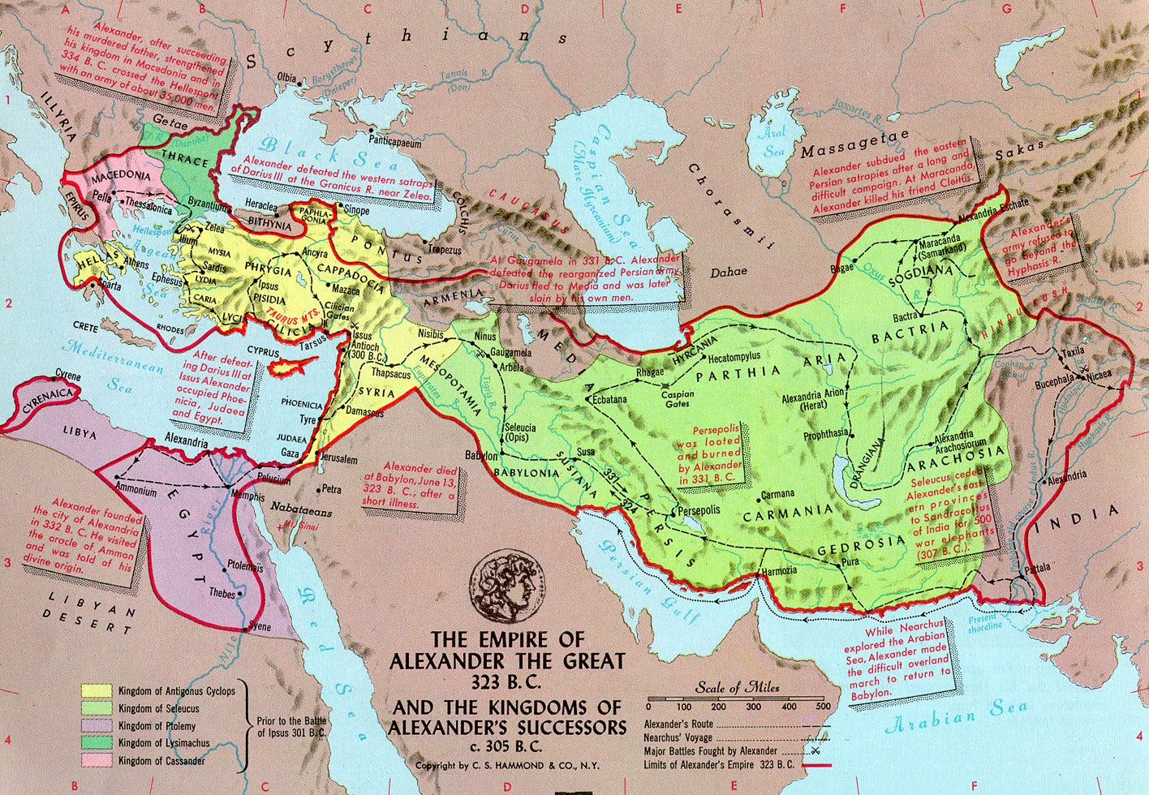

Slide 20
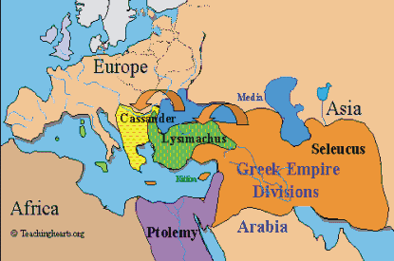

Slide 21
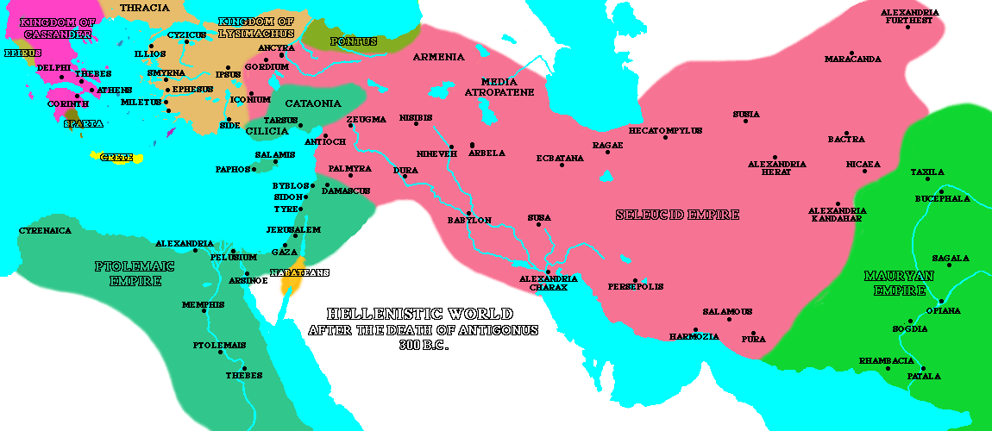
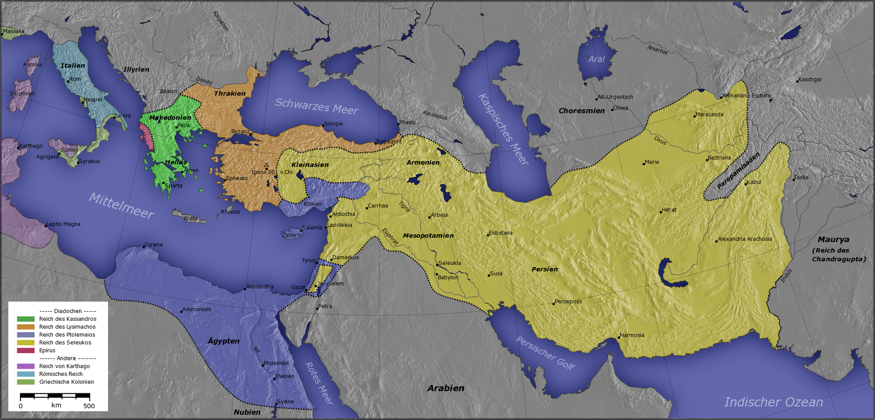

Slide 22
Daniel 8:9
And out of one of them came forth a little horn, which waxed exceeding great, toward the south, and toward the east, and toward the pleasant land.

Slide 23
Daniel 8:10
And it waxed great, even to the host of heaven; and it cast down some of the host and of the stars to the ground, and stamped upon them.

Slide 24
Isaiah 14:12
How art thou fallen from heaven, O Lucifer, son of the morning! how art thou cut down to the ground, which didst weaken the nations!

Slide 25
Isaiah 14:13
For thou hast said in thine heart, I will ascend into heaven, I will exalt my throne above the stars of God: I will sit also upon the mount of the congregation, in the sides of the north:

Slide 26
Isaiah 14:14
I will ascend above the heights of the clouds; I will be like the most High.

Slide 27
Revelation 12:4
And his tail drew the third part of the stars of heaven, and did cast them to the earth: and the dragon stood before the woman which was ready to be delivered, for to devour her child as soon as it was born.

Slide 28
Daniel 8:11
Yea, he magnified himself even to the prince of the host, and by him the daily sacrifice was taken away, and the place of his sanctuary was cast down.

Slide 29
Daniel 8:12
And an host was given him against the daily sacrifice by reason of transgression, and it cast down the truth to the ground; and it practised, and prospered.

Slide 30
John 10:22
And it was at Jerusalem the feast of the dedication, and it was winter.

Slide 31
Daniel 9:27a
And he shall confirm the covenant with many for one week: and in the midst of the week he shall cause the sacrifice and the oblation to cease,

Slide 32
Daniel 9:27b
and for the overspreading of abominations he shall make it desolate, even until the consummation, and that determined shall be poured upon the desolate.

Slide 33
Daniel 11:31
And arms shall stand on his part, and they shall pollute the sanctuary of strength, and shall take away the daily sacrifice, and they shall place the abomination that maketh desolate.

Slide 34
Daniel 12:11
And from the time that the daily sacrifice shall be taken away, and the abomination that maketh desolate set up, there shall be a thousand two hundred and ninety days.

Slide 35
Matthew 24:15
When ye therefore shall see the abomination of desolation, spoken of by Daniel the prophet, stand in the holy place, (whoso readeth, let him understand:)

Slide 36
Mark 13:14
But when ye shall see the abomination of desolation, spoken of by Daniel the prophet, standing where it ought not, (let him that readeth understand,) then let them that be in Judaea flee to the mountains:

Slide 37
2 Thessalonians 2:3
Let no man deceive you by any means: for that day shall not come, except there come a falling away first, and that man of sin be revealed, the son of perdition;

Slide 38
2 Thessalonians 2:4
Who opposeth and exalteth himself above all that is called God, or that is worshipped; so that he as God sitteth in the temple of God, shewing himself that he is God.

Slide 39
Revelation 13:2
And the beast which I saw was like unto a leopard, and his feet were as the feet of a bear, and his mouth as the mouth of a lion: and the dragon gave him his power, and his seat, and great authority.

Slide 40
Revelation 13:3
And I saw one of his heads as it were wounded to death; and his deadly wound was healed: and all the world wondered after the beast.

Slide 41
Revelation 13:4
And they worshipped the dragon which gave power unto the beast: and they worshipped the beast, saying, Who is like unto the beast? who is able to make war with him?

Slide 42
Revelation 13:5
And there was given unto him a mouth speaking great things and blasphemies; and power was given unto him to continue forty and two months.

Slide 43
Revelation 13:6
And he opened his mouth in blasphemy against God, to blaspheme his name, and his tabernacle, and them that dwell in heaven.

Slide 44
John 8:12
Then spake Jesus again unto them, saying, I am the light of the world: he that followeth me shall not walk in darkness, but shall have the light of life.

