Slide 1
Daniel 8:1-8
Wednesday,
April 8, 2015
Calvary Chapel of El Paso

Slide 2
Daniel 8:1
In the third year of the reign of king Belshazzar a vision appeared unto me, even unto me Daniel, after that which appeared unto me at the first.

Slide 3
Daniel 8:2
And I saw in a vision; and it came to pass, when I saw, that I was at Shushan in the palace, which is in the province of Elam; and I saw in a vision, and I was by the river of Ulai.

Slide 4
Daniel 8:3
Then I lifted up mine eyes, and saw, and, behold, there stood before the river a ram which had two horns: and the two horns were high; but one was higher than the other, and the higher came up last.

Slide 5
Daniel 8:4a
I saw the ram pushing westward, and northward, and southward; so that no beasts might stand before him,

Slide 6
Daniel 8:4b
neither was there any that could deliver out of his hand; but he did according to his will, and became great.

Slide 7
Daniel 8:5
And as I was considering, behold, an he goat came from the west on the face of the whole earth, and touched not the ground: and the goat had a notable horn between his eyes.

Slide 8
Daniel 8:6
And he came to the ram that had two horns, which I had seen standing before the river, and ran unto him in the fury of his power.

Slide 9
Daniel 8:7a
And I saw him come close unto the ram, and he was moved with choler against him, and smote the ram, and brake his two horns: and there was no power in the ram to stand before him,

Slide 10
Daniel 8:7b
but he cast him down to the ground, and stamped upon him: and there was none that could deliver the ram out of his hand.

Slide 11
Daniel 8:8
Therefore the he goat waxed very great: and when he was strong, the great horn was broken; and for it came up four notable ones toward the four winds of heaven.

Slide 13
1 Corinthians 10:32
Give none offence, neither to the Jews, nor to the Gentiles, nor to the church of God:

Slide 14
Proverbs 14:34
Righteousness exalteth a nation: but sin is a reproach to any people.

Slide 15
Daniel 8:1
In the third year of the reign of king Belshazzar a vision appeared unto me, even unto me Daniel, after that which appeared unto me at the first.

Slide 16
Daniel 8:2
And I saw in a vision; and it came to pass, when I saw, that I was at Shushan in the palace, which is in the province of Elam; and I saw in a vision, and I was by the river of Ulai.

Slide 17
Daniel 7:28
Hitherto is the end of the matter. As for me Daniel, my cogitations much troubled me, and my countenance changed in me: but I kept the matter in my heart.

Slide 18
Daniel 8:3
Then I lifted up mine eyes, and saw, and, behold, there stood before the river a ram which had two horns: and the two horns were high; but one was higher than the other, and the higher came up last.

Slide 19
Daniel 8:4a
I saw the ram pushing westward, and northward, and southward; so that no beasts might stand before him,

Slide 20
Daniel 8:4b
neither was there any that could deliver out of his hand; but he did according to his will, and became great.

Slide 21
Daniel 8:20
The ram which thou sawest having two horns are the kings of Media and Persia.

Slide 22
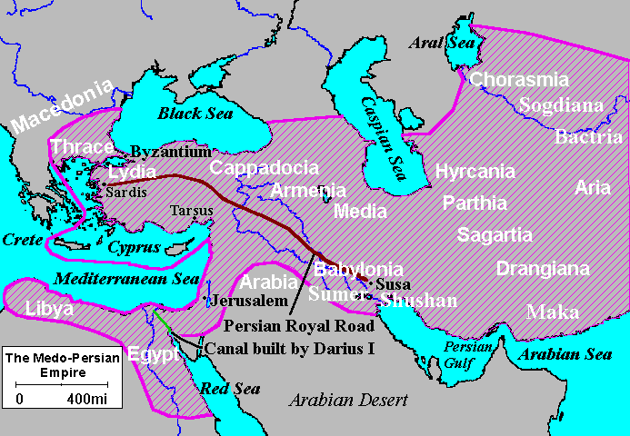

Slide 23
Proverbs 16:18
Pride goeth before destruction, and an haughty spirit before a fall.

Slide 24
Daniel 8:5
And as I was considering, behold, an he goat came from the west on the face of the whole earth, and touched not the ground: and the goat had a notable horn between his eyes.

Slide 25
Daniel 8:6
And he came to the ram that had two horns, which I had seen standing before the river, and ran unto him in the fury of his power.

Slide 26
Daniel 8:7a
And I saw him come close unto the ram, and he was moved with choler against him, and smote the ram, and brake his two horns: and there was no power in the ram to stand before him,

Slide 27
Daniel 8:7b
but he cast him down to the ground, and stamped upon him: and there was none that could deliver the ram out of his hand.

Slide 28
Daniel 8:8
Therefore the he goat waxed very great: and when he was strong, the great horn was broken; and for it came up four notable ones toward the four winds of heaven.

Slide 29
Daniel 8:20
The ram which thou sawest having two horns are the kings of Media and Persia.

Slide 30
Daniel 8:21
And the rough goat is the king of Grecia: and the great horn that is between his eyes is the first king.

Slide 31
2 Peter 1:2
Grace and peace be multiplied unto you through the knowledge of God, and of Jesus our Lord,

Slide 32
2 Peter 1:3
According as his divine power hath given unto us all things that pertain unto life and godliness, through the knowledge of him that hath called us to glory and virtue:

Slide 33
2 Peter 1:4
Whereby are given unto us exceeding great and precious promises: that by these ye might be partakers of the divine nature, having escaped the corruption that is in the world through lust.

Slide 34
Philippians 4:19
But my God shall supply all your need according to his riches in glory by Christ Jesus.

