Slide 1
Daniel 7:1-6
Wednesday, March 4, 2015
Calvary Chapel of El Paso

Slide 2
Daniel 7:1
In the first year of Belshazzar king of Babylon Daniel had a dream and visions of his head upon his bed: then he wrote the dream, and told the sum of the matters.

Slide 3
Daniel 7:2
Daniel spake and said, I saw in my vision by night, and, behold, the four winds of the heaven strove upon the great sea.

Slide 4
Daniel 7:3
And four great beasts came up from the sea, diverse one from another.

Slide 5
Daniel 7:4
The first was like a lion, and had eagle's wings: I beheld till the wings thereof were plucked, and it was lifted up from the earth, and made stand upon the feet as a man, and a man's heart was given to it.

Slide 6
Daniel 7:5
And behold another beast, a second, like to a bear, and it raised up itself on one side, and it had three ribs in the mouth of it between the teeth of it: and they said thus unto it, Arise, devour much flesh.

Slide 7
Daniel 7:6
After this I beheld, and lo another, like a leopard, which had upon the back of it four wings of a fowl; the beast had also four heads; and dominion was given to it.

Slide 8
Daniel 7:7a
After this I saw in the night visions, and behold a fourth beast, dreadful and terrible, and strong exceedingly; and it had great iron teeth:

Slide 9
Daniel 7:7b
it devoured and brake in pieces, and stamped the residue with the feet of it: and it was diverse from all the beasts that were before it; and it had ten horns.

Slide 10
Daniel 7:8a
I considered the horns, and, behold, there came up among them another little horn, before whom there were three of the first horns plucked up by the roots:

Slide 11
Daniel 7:8b
and, behold, in this horn were eyes like the eyes of man, and a mouth speaking great things.

Slide 13
Psalm 49:12
Nevertheless man being in honour abideth not (will not last): he is like the beasts that perish.

Slide 14
Daniel 7:2
Daniel spake and said, I saw in my vision by night, and, behold, the four winds of the heaven strove upon the great sea.

Slide 15
Daniel 7:3
And four great beasts came up from the sea, diverse one from another.

Slide 16
Revelation 7:1
And after these things I saw four angels standing on the four corners of the earth, holding the four winds of the earth, that the wind should not blow on the earth, nor on the sea, nor on any tree.

Slide 17
Revelation 13:1
And I stood upon the sand of the sea, and saw a beast rise up out of the sea, having seven heads and ten horns, and upon his horns ten crowns, and upon his heads the name of blasphemy.

Slide 18
Revelation 13:2
And the beast which I saw was like unto a leopard, and his feet were as the feet of a bear, and his mouth as the mouth of a lion: and the dragon gave him his power, and his seat, and great authority.

Slide 19
Revelation 17:15
And he saith unto me, The waters which thou sawest, where the whore sitteth, are peoples, and multitudes, and nations, and tongues.

Slide 20
Isaiah 17:12
Woe to the multitude of many people, which make a noise like the noise of the seas; and to the rushing of nations, that make a rushing like the rushing of mighty waters!

Slide 21
The Winged Lion—Babylon!

Slide 22
Daniel 7:4
The first was like a lion, and had eagle's wings: I beheld till the wings thereof were plucked, and it was lifted up from the earth, and made stand upon the feet as a man, and a man's heart was given to it.

Slide 23
Jeremiah 4:7
The lion is come up from his thicket, and the destroyer of the Gentiles is on his way; he is gone forth from his place to make thy land desolate; and thy cities shall be laid waste, without an inhabitant.

Slide 24
Ezekiel 17:3
And say, Thus saith the Lord GOD; A great eagle with great wings, longwinged, full of feathers, which had divers colours, came unto Lebanon, and took the highest branch of the cedar:

Slide 25
The Bear with Ribs—
Medo-Persia!

Slide 26
Daniel 7:5
And behold another beast, a second, like to a bear, and it raised up itself on one side, and it had three ribs in the mouth of it between the teeth of it: and they said thus unto it, Arise, devour much flesh.

Slide 27
The Winged Four-Headed Leopard—Greece (Macedonia)!

Slide 28
Daniel 7:6
After this I beheld, and lo another, like a leopard, which had upon the back of it four wings of a fowl; the beast had also four heads; and dominion was given to it.

Slide 29
Daniel 11:3
And a mighty king shall stand up, that shall rule with great dominion, and do according to his will.

Slide 30
2 Peter 1:19
We have also a more sure word of prophecy; whereunto ye do well that ye take heed, as unto a light that shineth in a dark place, until the day dawn, and the day star arise in your hearts:

Slide 31
2 Peter 1:20
Knowing this first, that no prophecy of the scripture is of any private interpretation.

Slide 32
2 Peter 1:21
For the prophecy came not in old time by the will of man: but holy men of God spake as they were moved by the Holy Ghost.

Slide 33
Isaiah 46:9
Remember the former things of old: for I am God, and there is none else; I am God, and there is none like me,

Slide 34
Isaiah 46:10
Declaring the end from the beginning, and from ancient times the things that are not yet done, saying, My counsel shall stand, and I will do all my pleasure:

Slide 35
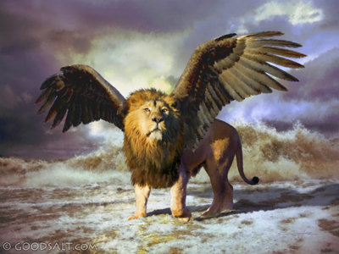

Slide 36
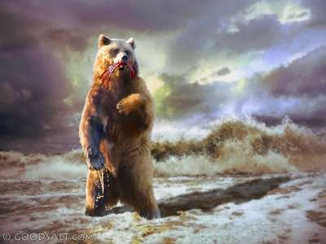

Slide 37
