Slide 1
Daniel 4:1-18
January 28, 2015
Calvary Chapel of El Paso

Slide 2
Daniel 4:1
Nebuchadnezzar the king, unto all people, nations, and languages, that dwell in all the earth; Peace be multiplied unto you.

Slide 3
Daniel 4:2
I thought it good to shew the signs and wonders that the high God hath wrought toward me.

Slide 4
Daniel 4:3
How great are his signs! and how mighty are his wonders! his kingdom is an everlasting kingdom, and his dominion is from generation to generation.

Slide 5
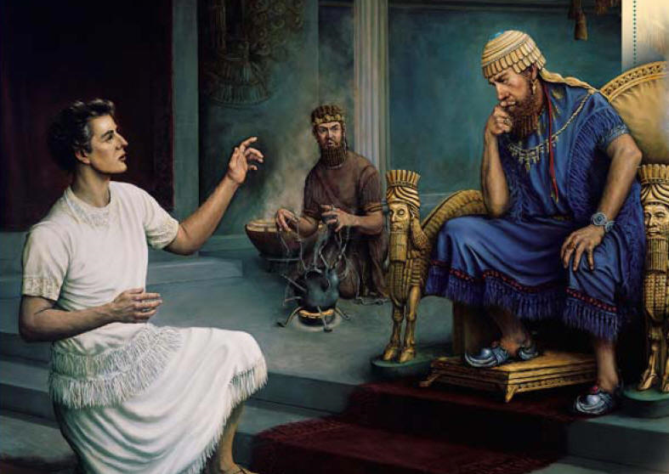

Slide 6
Greeting

Slide 7
Daniel 4:1
Nebuchadnezzar the king, unto all people, nations, and languages, that dwell in all the earth; Peace be multiplied unto you.

Slide 8
2 Timothy 3:16
All scripture is given by inspiration of God, and is profitable for doctrine, for reproof, for correction, for instruction in righteousness:

Slide 9
2 Timothy 3:17
That the man of God may be perfect, thoroughly furnished unto all good works.

Slide 10
Daniel 4:2
I thought it good to shew the signs and wonders that the high God hath wrought toward me.

Slide 11
Daniel 4:3
How great are his signs! and how mighty are his wonders! his kingdom is an everlasting kingdom, and his dominion is from generation to generation.

Slide 12
Psalm 145:10
All thy works shall praise thee, O LORD; and thy saints shall bless thee.

Slide 13
Psalm 145:11
They shall speak of the glory of thy kingdom, and talk of thy power;

Slide 14
Psalm 145:12
To make known to the sons of men his mighty acts, and the glorious majesty of his kingdom.

Slide 15
Psalm 145:13
Thy kingdom is an everlasting kingdom, and thy dominion endureth throughout all generations.

Slide 16
2 Peter 1:10
Wherefore the rather, brethren, give diligence to make your calling and election sure: for if ye do these things, ye shall never fall:

Slide 17
2 Peter 1:11
For so an entrance shall be ministered unto you abundantly into the everlasting kingdom of our Lord and Saviour Jesus Christ.

Slide 18
The Setting

Slide 19
Daniel 4:4
I Nebuchadnezzar was at rest in mine house, and flourishing in my palace:

Slide 20
Daniel 4:5
I saw a dream which made me afraid, and the thoughts upon my bed and the visions of my head troubled me.

Slide 21
Daniel 4:6
Therefore made I a decree to bring in all the wise men of Babylon before me, that they might make known unto me the interpretation of the dream.

Slide 22
Daniel 4:7
Then came in the magicians, the astrologers, the Chaldeans, and the soothsayers: and I told the dream before them; but they did not make known unto me the interpretation thereof.

Slide 23
Galatians 2:20
I am crucified with Christ: nevertheless I live; yet not I, but Christ liveth in me: and the life which I now live in the flesh I live by the faith of the Son of God, who loved me, and gave himself for me.

Slide 24
Last But Not Least!

Slide 25
Daniel 4:8
But at the last Daniel came in before me, whose name was Belteshazzar, according to the name of my god, and in whom is the spirit of the holy gods: and before him I told the dream, saying,

Slide 26
Daniel 4:9
O Belteshazzar, master of the magicians, because I know that the spirit of the holy gods is in thee, and no secret troubleth thee, tell me the visions of my dream that I have seen, and the interpretation thereof.

Slide 27
Daniel 2:47
The king answered unto Daniel, and said, Of a truth it is, that your God is a God of gods, and a Lord of kings, and a revealer of secrets, seeing thou couldest reveal this secret.

Slide 28
The Dream

Slide 29
Daniel 4:10
Thus were the visions of mine head in my bed; I saw, and behold a tree in the midst of the earth, and the height thereof was great.

Slide 30
Daniel 4:11
The tree grew, and was strong, and the height thereof reached unto heaven, and the sight thereof to the end of all the earth:

Slide 31
Daniel 4:12
The leaves thereof were fair, and the fruit thereof much, and in it was meat for all: the beasts of the field had shadow under it, and the fowls of the heaven dwelt in the boughs thereof, and all flesh was fed of it.

Slide 32
Daniel 4:13
I saw in the visions of my head upon my bed, and, behold, a watcher and an holy one came down from heaven;

Slide 33
Daniel 4:14
He cried aloud, and said thus, Hew down the tree, and cut off his branches, shake off his leaves, and scatter his fruit: let the beasts get away from under it, and the fowls from his branches:

Slide 34
Daniel 4:15a
Nevertheless leave the stump of his roots in the earth, even with a band of iron and brass, in the tender grass of the field;

Slide 35
Daniel 4:15b
and let it be wet with the dew of heaven, and let his portion be with the beasts in the grass of the earth:

Slide 36
Daniel 4:16
Let his heart be changed from man's, and let a beast's heart be given unto him; and let seven times pass over him.

Slide 37
Daniel 4:17a
This matter is by the decree of the watchers, and the demand by the word of the holy ones: to the intent that the living may know that the most High ruleth in the kingdom of men,

Slide 38
Daniel 4:17b
and giveth it to whomsoever he will, and setteth up over it the basest of men.

Slide 39
Daniel 4:18a
This dream I king Nebuchadnezzar have seen. Now thou, O Belteshazzar, declare the interpretation thereof,

Slide 40
Daniel 4:18b
forasmuch as all the wise men of my kingdom are not able to make known unto me the interpretation: but thou art able; for the spirit of the holy gods is in thee.

Slide 41
Jeremiah 5:27
As a cage is full of birds, so are their houses full of deceit: therefore they are become great, and waxen rich.

Slide 42
Revelation 18:2
And he cried mightily with a strong voice, saying, Babylon the great is fallen, is fallen, and is become the habitation of devils, and the hold of every foul spirit, and a cage of every unclean and hateful bird.

Slide 43
Ephesians 6:12
For we wrestle not against flesh and blood, but against principalities, against powers, against the rulers of the darkness of this world, against spiritual wickedness in high places.

Slide 44
Hebrews 1:7
And of the angels he saith, Who maketh his angels spirits, and his ministers a flame of fire.

