Slide 1
Daniel 2:41-49
December 3, 2014
Calvary Chapel of El Paso

Slide 2
Daniel 2:41a
And whereas thou sawest the feet and toes, part of potters' clay, and part of iron, the kingdom shall be divided;

Slide 3
Daniel 2:41b
but there shall be in it of the strength of the iron, forasmuch as thou sawest the iron mixed with miry clay.

Slide 4
Daniel 2:42
And as the toes of the feet were part of iron, and part of clay, so the kingdom shall be partly strong, and partly broken.

Slide 5
Daniel 2:43
And whereas thou sawest iron mixed with miry clay, they shall mingle themselves with the seed of men: but they shall not cleave one to another, even as iron is not mixed with clay.

Slide 6
Daniel 2:44a
And in the days of these kings shall the God of heaven set up a kingdom, which shall never be destroyed:

Slide 7
Daniel 2:44b
and the kingdom shall not be left to other people, but it shall break in pieces and consume all these kingdoms, and it shall stand for ever.

Slide 8
Daniel 2:45a
Forasmuch as thou sawest that the stone was cut out of the mountain without hands, and that it brake in pieces the iron, the brass, the clay, the silver, and the gold;

Slide 9
Daniel 2:45b
the great God hath made known to the king what shall come to pass hereafter: and the dream is certain, and the interpretation thereof sure.

Slide 10
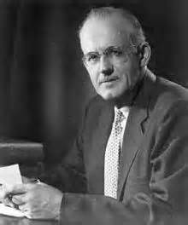

Slide 11
Daniel 2:27
Daniel answered in the presence of the king, and said, The secret which the king hath demanded cannot the wise men, the astrologers, the magicians, the soothsayers, shew unto the king;

Slide 12
Daniel 2:28
But there is a God in heaven that revealeth secrets, and maketh known to the king Nebuchadnezzar what shall be in the latter days. Thy dream, and the visions of thy head upon thy bed, are these;

Slide 14
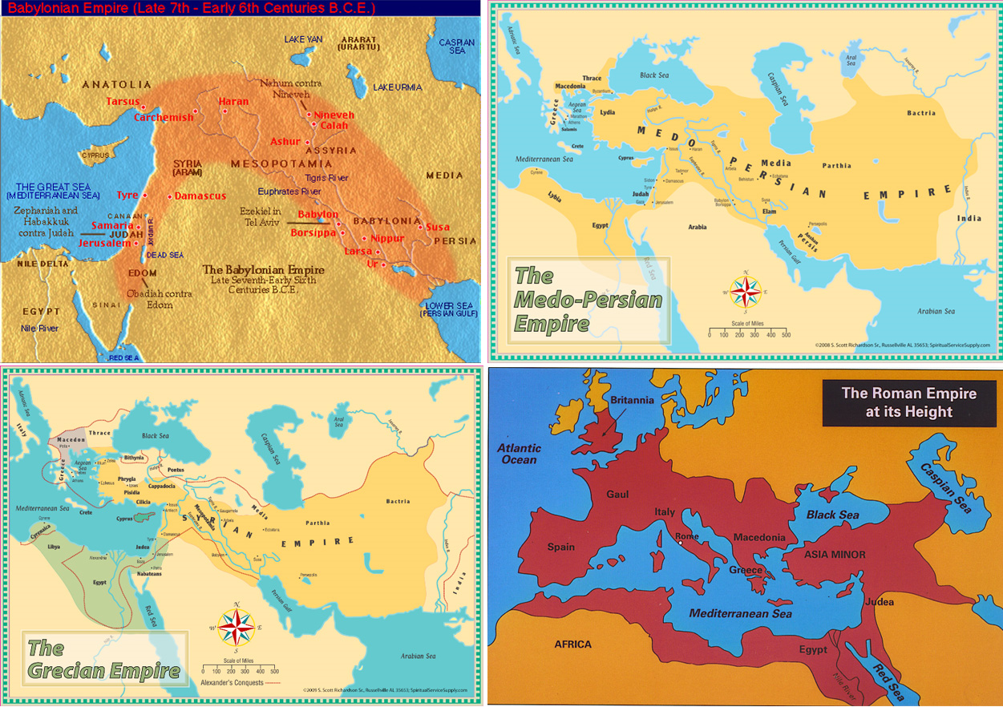

Slide 15
Daniel 2:40
And the fourth kingdom shall be strong as iron: forasmuch as iron breaketh in pieces and subdueth all things: and as iron that breaketh all these, shall it break in pieces and bruise.

Slide 16
Daniel 2:41a
And whereas thou sawest the feet and toes, part of potters' clay, and part of iron, the kingdom shall be divided;

Slide 17
Daniel 2:41b
but there shall be in it of the strength of the iron, forasmuch as thou sawest the iron mixed with miry clay.

Slide 18
Daniel 2:42
And as the toes of the feet were part of iron, and part of clay, so the kingdom shall be partly strong, and partly broken.

Slide 19
Daniel 2:43
And whereas thou sawest iron mixed with miry clay, they shall mingle themselves with the seed of men: but they shall not cleave one to another, even as iron is not mixed with clay.

Slide 20
Isaiah 64:8
But now, O LORD, thou art our father; we are the clay, and thou our potter; and we all are the work of thy hand.

Slide 21
Job 10:9
Remember, I beseech thee, that thou hast made me as the clay; and wilt thou bring me into dust again?

Slide 22
Isaiah 29:16
Surely your turning of things upside down shall be esteemed as the potter's clay: for shall the work say of him that made it, He made me not? or shall the thing framed say of him that framed it, He had no understanding?

Slide 23
Jeremiah 18:4
And the vessel that he made of clay was marred in the hand of the potter: so he made it again another vessel, as seemed good to the potter to make it.

Slide 24
Jeremiah 18:5
Then the word of the LORD came to me, saying,

Slide 25
Jeremiah 18:6
O house of Israel, cannot I do with you as this potter? saith the LORD. Behold, as the clay is in the potter's hand, so are ye in mine hand, O house of Israel.

Slide 26
Romans 9:21
Hath not the potter power over the clay, of the same lump to make one vessel unto honour, and another unto dishonour?

Slide 27
Daniel 2:44a
And in the days of these kings shall the God of heaven set up a kingdom, which shall never be destroyed:

Slide 28
Daniel 2:44b
and the kingdom shall not be left to other people, but it shall break in pieces and consume all these kingdoms, and it shall stand for ever.

Slide 29
Daniel 2:45a
Forasmuch as thou sawest that the stone was cut out of the mountain without hands, and that it brake in pieces the iron, the brass, the clay, the silver, and the gold;

Slide 30
Daniel 2:45b
the great God hath made known to the king what shall come to pass hereafter: and the dream is certain, and the interpretation thereof sure.

Slide 31
Psalm 118:8
It is better to trust in the LORD than to put confidence in man.

Slide 32
Psalm 118:9
It is better to trust in the LORD than to put confidence in princes.

Slide 33
1 Peter 2:6
Wherefore also it is contained in the scripture, Behold, I lay in Sion a chief corner stone, elect, precious: and he that believeth on him shall not be confounded.

Slide 34
1 Peter 2:7
Unto you therefore which believe he is precious: but unto them which be disobedient, the stone which the builders disallowed, the same is made the head of the corner,

Slide 35
1 Peter 2:8
And a stone of stumbling, and a rock of offence, even to them which stumble at the word, being disobedient: whereunto also they were appointed.

Slide 36
Matthew 21:42
Jesus saith unto them, Did ye never read in the scriptures, The stone which the builders rejected, the same is become the head of the corner: this is the Lord's doing, and it is marvellous in our eyes?

Slide 37
Matthew 21:43
Therefore say I unto you, The kingdom of God shall be taken from you, and given to a nation bringing forth the fruits thereof.

Slide 38
Matthew 21:44
And whosoever shall fall on this stone shall be broken: but on whomsoever it shall fall, it will grind him to powder.

Slide 39
John 1:12
But as many as received him, to them gave he power to become the sons of God, even to them that believe on his name:

Slide 40
John 1:13
Which were born, not of blood, nor of the will of the flesh, nor of the will of man, but of God.

Slide 41
John 1:14
And the Word was made flesh, and dwelt among us, (and we beheld his glory, the glory as of the only begotten of the Father,) full of grace and truth.

Slide 42
Daniel 2:46
Then the king Nebuchadnezzar fell upon his face, and worshipped Daniel, and commanded that they should offer an oblation and sweet odours unto him.

Slide 43
Daniel 2:47
The king answered unto Daniel, and said, Of a truth it is, that your God is a God of gods, and a Lord of kings, and a revealer of secrets, seeing thou couldest reveal this secret.

Slide 44
Daniel 2:48
Then the king made Daniel a great man, and gave him many great gifts, and made him ruler over the whole province of Babylon, and chief of the governors over all the wise men of Babylon.

Slide 45
Daniel 2:49
Then Daniel requested of the king, and he set Shadrach, Meshach, and Abednego, over the affairs of the province of Babylon: but Daniel sat in the gate of the king.

Slide 46
