Slide 1
Daniel 11:36
Wednesday, July 15, 2015
Calvary Chapel of El Paso

Slide 2
Daniel 11:36a
And the king shall do according to his will; and he shall exalt himself, and magnify himself above every god, and shall speak marvellous things against the God of gods,

Slide 3
Daniel 11:36b
and shall prosper till the indignation be accomplished: for that that is determined shall be done.

Slide 4
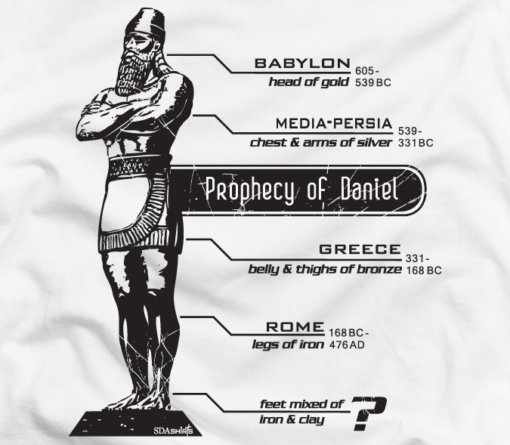

Slide 5
Daniel 11:35
And some of them of understanding shall fall, to try them, and to purge, and to make them white, even to the time of the end: because it is yet for a time appointed.

Slide 6
Daniel 2:31
Thou, O king, sawest, and behold a great image. This great image, whose brightness was excellent, stood before thee; and the form thereof was terrible.

Slide 7
Daniel 2:32
This image's head was of fine gold, his breast and his arms of silver, his belly and his thighs of brass,

Slide 8
Daniel 2:33
His legs of iron, his feet part of iron and part of clay.

Slide 9
Daniel 2:34
Thou sawest till that a stone was cut out without hands, which smote the image upon his feet that were of iron and clay, and brake them to pieces.

Slide 10
Daniel 2:35a
Then was the iron, the clay, the brass, the silver, and the gold, broken to pieces together, and became like the chaff of the summer threshingfloors;

Slide 11
Daniel 2:35b
and the wind carried them away, that no place was found for them: and the stone that smote the image became a great mountain, and filled the whole earth.

Slide 12
Daniel 7:7a
After this I saw in the night visions, and behold a fourth beast, dreadful and terrible, and strong exceedingly; and it had great iron teeth:

Slide 13
Daniel 7:7b
it devoured and brake in pieces, and stamped the residue with the feet of it: and it was diverse from all the beasts that were before it; and it had ten horns.

Slide 14
Daniel 7:8a
I considered the horns, and, behold, there came up among them another little horn, before whom there were three of the first horns plucked up by the roots:

Slide 15
Daniel 7:8b
and, behold, in this horn were eyes like the eyes of man, and a mouth speaking great things.

Slide 16
PRIDE: The King Shall Do According To His Will

Slide 17
Daniel 11:36a
And the king shall do according to his will; and he shall exalt himself, and magnify himself above every god, and shall speak marvellous things against the God of gods,

Slide 18
Daniel 11:36b
and shall prosper till the indignation be accomplished: for that that is determined shall be done.

Slide 19
Daniel 11:21
And in his estate shall stand up a vile person, to whom they shall not give the honour of the kingdom: but he shall come in peaceably, and obtain the kingdom by flatteries.

Slide 20
Revelation 6:1
And I saw when the Lamb opened one of the seals, and I heard, as it were the noise of thunder, one of the four beasts saying, Come and see.

Slide 21
Revelation 6:2
And I saw, and behold a white horse: and he that sat on him had a bow; and a crown was given unto him: and he went forth conquering, and to conquer.

Slide 22
Daniel 9:26a
And after threescore and two weeks shall Messiah be cut off, but not for himself: and the people of the prince that shall come shall destroy the city and the sanctuary;

Slide 23
Daniel 9:26b
and the end thereof shall be with a flood, and unto the end of the war desolations are determined.

Slide 24
Daniel 9:27a
And he shall confirm the covenant with many for one week: and in the midst of the week he shall cause the sacrifice and the oblation to cease,

Slide 25
Daniel 9:27b
and for the overspreading of abominations he shall make it desolate, even until the consummation, and that determined shall be poured upon the desolate.

Slide 26
1 Thessalonians 5:3
For when they shall say, Peace and safety; then sudden destruction cometh upon them, as travail upon a woman with child; and they shall not escape.

Slide 27
2 Thessalonians 2:3
Let no man deceive you by any means: for that day shall not come, except there come a falling away first, and that man of sin be revealed, the son of perdition;

Slide 28
2 Thessalonians 2:4
Who opposeth and exalteth himself above all that is called God, or that is worshipped; so that he as God sitteth in the temple of God, shewing himself that he is God.

Slide 29
PRIDE: Self-Exaltation and Magnification

Slide 30
Daniel 7:25a
And he shall speak great words against the most High, and shall wear out the saints of the most High, and think to change times and laws:

Slide 31
Daniel 7:25b
and they shall be given into his hand until a time and times and the dividing of time.

Slide 32
Revelation 13:5
And there was given unto him a mouth speaking great things and blasphemies; and power was given unto him to continue forty and two months.

Slide 33
Revelation 13:6
And he opened his mouth in blasphemy against God, to blaspheme his name, and his tabernacle, and them that dwell in heaven.

Slide 34
Revelation 13:7
And it was given unto him to make war with the saints, and to overcome them: and power was given him over all kindreds, and tongues, and nations.

Slide 35
Revelation 13:8
And all that dwell upon the earth shall worship him, whose names are not written in the book of life of the Lamb slain from the foundation of the world.

Slide 36
PRIDE: His Success Will Be Short-Lived

Slide 37
2 Thessalonians 2:10
And with all deceivableness of unrighteousness in them that perish; because they received not the love of the truth, that they might be saved.

Slide 38
2 Thessalonians 2:11
And for this cause God shall send them strong delusion, that they should believe a lie:

Slide 39
2 Thessalonians 2:12
That they all might be damned who believed not the truth, but had pleasure in unrighteousness.

Slide 40
Romans 1:18
For the wrath of God is revealed from heaven against all ungodliness and unrighteousness of men, who hold the truth in unrighteousness;

Slide 41
Romans 1:19
Because that which may be known of God is manifest in them; for God hath shewed it unto them.

Slide 42
Romans 1:20
For the invisible things of him from the creation of the world are clearly seen, being understood by the things that are made, even his eternal power and Godhead; so that they are without excuse:

Slide 43
Romans 1:21
Because that, when they knew God, they glorified him not as God, neither were thankful; but became vain in their imaginations, and their foolish heart was darkened.

Slide 44
Romans 1:22
Professing themselves to be wise, they became fools,

Slide 45
Romans 1:23
And changed the glory of the uncorruptible God into an image made like to corruptible man, and to birds, and fourfooted beasts, and creeping things.

Slide 46
Romans 1:24
Wherefore God also gave them up to uncleanness through the lusts of their own hearts, to dishonour their own bodies between themselves:

Slide 47
Romans 1:26
For this cause God gave them up unto vile affections: for even their women did change the natural use into that which is against nature:

Slide 48
Romans 1:28
And even as they did not like to retain God in their knowledge, God gave them over to a reprobate mind, to do those things which are not convenient;

Slide 49
1 Thessalonians 5:6
Therefore let us not sleep, as do others; but let us watch and be sober.

Slide 50
1 Thessalonians 5:7
For they that sleep sleep in the night; and they that be drunken are drunken in the night.

Slide 51
1 Thessalonians 5:8
But let us, who are of the day, be sober, putting on the breastplate of faith and love; and for an helmet, the hope of salvation.

Slide 52
1 Thessalonians 5:9
For God hath not appointed us to wrath, but to obtain salvation by our Lord Jesus Christ,

Slide 53
1 Thessalonians 5:10
Who died for us, that, whether we wake or sleep, we should live together with him.

