Slide 1
Daniel 11:1-4
Wednesday, June 24, 2015
Calvary Chapel of El Paso

Slide 2
Daniel 11:1
Also I in the first year of Darius the Mede, even I, stood to confirm and to strengthen him.

Slide 3
Daniel 11:2a
And now will I shew thee the truth. Behold, there shall stand up yet three kings in Persia; and the fourth shall be far richer than they all:

Slide 4
Daniel 11:2b
and by his strength through his riches he shall stir up all against the realm of Grecia.

Slide 5
Daniel 11:3
And a mighty king shall stand up, that shall rule with great dominion, and do according to his will.

Slide 6
Daniel 11:4a
And when he shall stand up, his kingdom shall be broken, and shall be divided toward the four winds of heaven;

Slide 7
Daniel 11:4b
and not to his posterity, nor according to his dominion which he ruled: for his kingdom shall be plucked up, even for others beside those.

Slide 9
Psalm 138:2
I will worship toward thy holy temple, and praise thy name for thy lovingkindness and for thy truth: for thou hast magnified thy word above all thy name.

Slide 10
Daniel 12:1a
And at that time shall Michael stand up, the great prince which standeth for the children of thy people: and there shall be a time of trouble,

Slide 11
Daniel 12:1b
such as never was since there was a nation even to that same time: and at that time thy people shall be delivered, every one that shall be found written in the book.

Slide 12
1 Thessalonians 4:16
For the Lord himself shall descend from heaven with a shout, with the voice of the archangel, and with the trump of God: and the dead in Christ shall rise first:

Slide 13
Jude 9
Yet Michael the archangel, when contending with the devil he disputed about the body of Moses, durst not bring against him a railing accusation, but said, The Lord rebuke thee.

Slide 14
Revelation 12:7
And there was war in heaven: Michael and his angels fought against the dragon; and the dragon fought and his angels,

Slide 15
Daniel 10:20
Then said he, Knowest thou wherefore I come unto thee? and now will I return to fight with the prince of Persia: and when I am gone forth, lo, the prince of Grecia shall come.

Slide 16
Daniel 10:21
But I will shew thee that which is noted in the scripture of truth: and there is none that holdeth with me in these things, but Michael your prince.

Slide 17
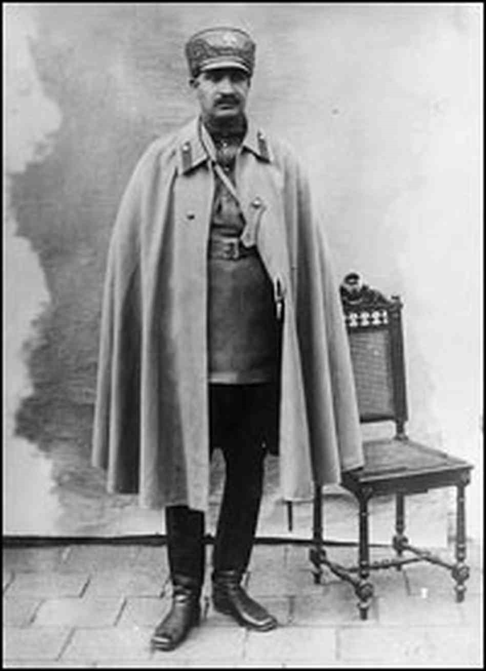

Slide 18
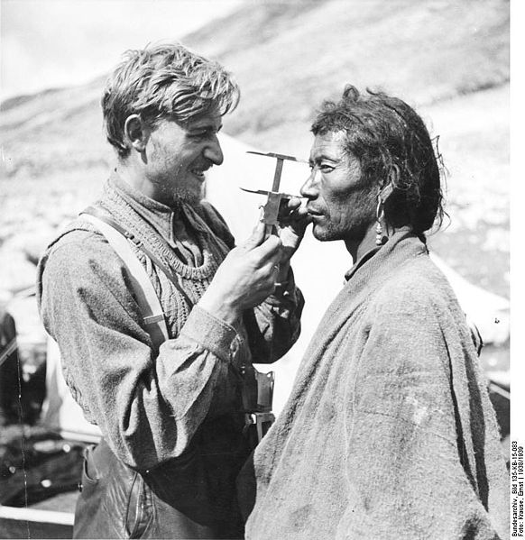

Slide 19
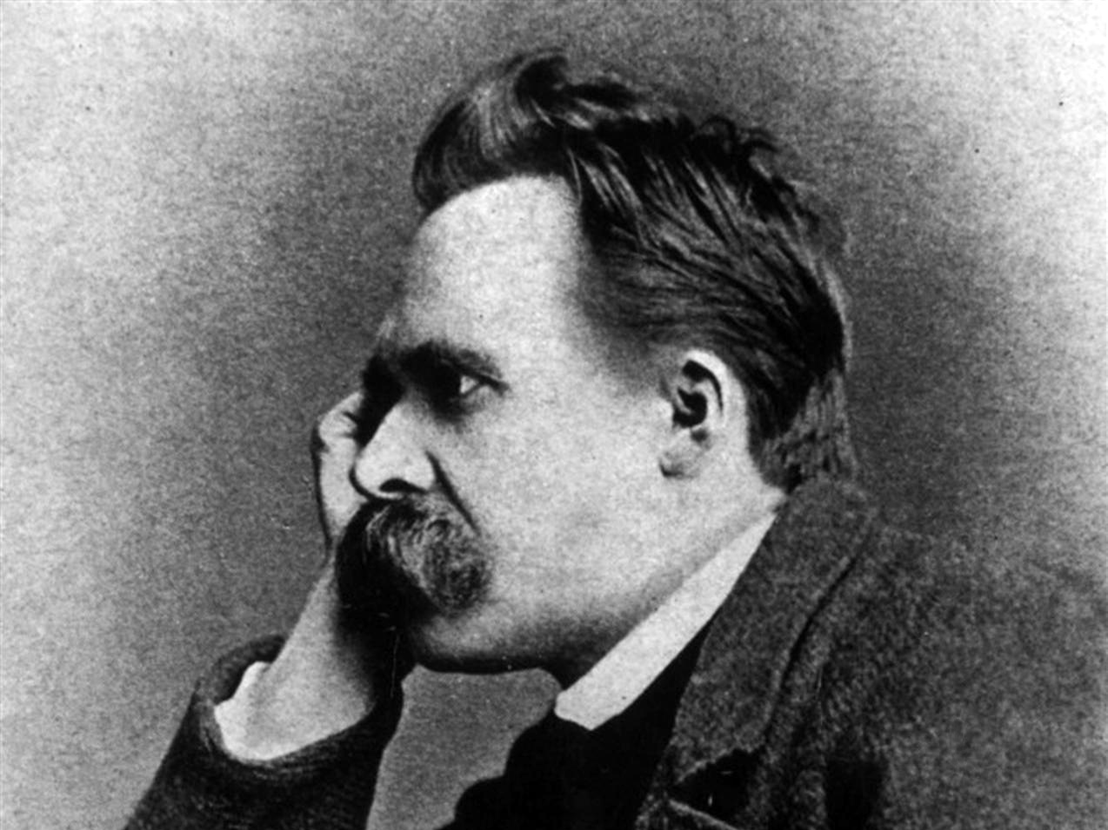

Slide 20
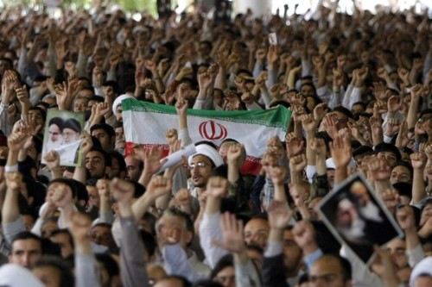

Slide 21
Daniel 11:1
Also I in the first year of Darius the Mede, even I, stood to confirm and to strengthen him.

Slide 22
Daniel 11:2a
And now will I shew thee the truth. Behold, there shall stand up yet three kings in Persia; and the fourth shall be far richer than they all:

Slide 23
Daniel 11:2b
and by his strength through his riches he shall stir up all against the realm of Grecia.

Slide 24
Daniel 11:3
And a mighty king shall stand up, that shall rule with great dominion, and do according to his will.

Slide 25
Daniel 11:4a
And when he shall stand up, his kingdom shall be broken, and shall be divided toward the four winds of heaven;

Slide 26
Daniel 11:4b
and not to his posterity, nor according to his dominion which he ruled: for his kingdom shall be plucked up, even for others beside those.

Slide 27
Psalm 40:7
Then said I, Lo, I come: in the volume of the book it is written of me,

Slide 28
Psalm 40:8
I delight to do thy will, O my God: yea, thy law is within my heart.

Slide 29
Ephesians 1:7
In whom we have redemption through his blood, the forgiveness of sins, according to the riches of his grace;

Slide 30
Ephesians 1:8
Wherein he hath abounded toward us in all wisdom and prudence;

Slide 31
Ephesians 1:9
Having made known unto us the mystery of his will, according to his good pleasure which he hath purposed in himself:

Slide 32
Ephesians 1:10
That in the dispensation of the fulness of times he might gather together in one all things in Christ, both which are in heaven, and which are on earth; even in him:

Slide 33
Ephesians 1:11
In whom also we have obtained an inheritance, being predestinated according to the purpose of him who worketh all things after the counsel of his own will:

Slide 34
Ephesians 1:12
That we should be to the praise of his glory, who first trusted in Christ.

Slide 35
Ephesians 1:13
In whom ye also trusted, after that ye heard the word of truth, the gospel of your salvation: in whom also after that ye believed, ye were sealed with that holy Spirit of promise,

Slide 36
Ephesians 1:14
Which is the earnest of our inheritance until the redemption of the purchased possession, unto the praise of his glory.

