Slide 1
“Crisis Management”
Genesis 47
August 9-10, 2014
Calvary Chapel of El Paso

Slide 2
Genesis 47:1
Then Joseph went and told Pharaoh, and said, "My father and my brothers, their flocks and their herds and all that they possess, have come from the land of Canaan; and indeed they are in the land of Goshen."

Slide 3
Genesis 47:2
And he took five men from among his brothers and presented them to Pharaoh.

Slide 4
Genesis 47:3
Then Pharaoh said to his brothers, "What is your occupation?" And they said to Pharaoh, "Your servants are shepherds, both we and also our fathers."

Slide 5
Genesis 47:4a
And they said to Pharaoh, "We have come to dwell (sojourn) in the land, because your servants have no pasture for their flocks, for the famine is severe in the land of Canaan.

Slide 6
Genesis 47:4b
Now therefore, please let your servants dwell in the land of Goshen."

Slide 7
Genesis 47:5
Then Pharaoh spoke to Joseph, saying, "Your father and your brothers have come to you.

Slide 8
Genesis 47:6a
The land of Egypt is before you. Have your father and brothers dwell in the best of the land; let them dwell in the land of Goshen.

Slide 9
Genesis 47:6b
And if you know any competent men among them, then make them chief herdsmen over my livestock."

Slide 10
Genesis 47:7
Then Joseph brought in his father Jacob and set him before Pharaoh; and Jacob blessed Pharaoh.

Slide 11
Genesis 47:8
Pharaoh said to Jacob, "How old are you?"

Slide 12
Genesis 47:9a
And Jacob said to Pharaoh, "The days of the years of my pilgrimage are one hundred and thirty years; few and evil have been the days of the years of my life,

Slide 13
Genesis 47:9b
and they have not attained to the days of the years of the life of my fathers in the days of their pilgrimage."

Slide 14
Genesis 47:10
So Jacob blessed Pharaoh, and went out from before Pharaoh.

Slide 15
Genesis 47:11
And Joseph situated his father and his brothers, and gave them a possession in the land of Egypt, in the best of the land, in the land of Rameses, as Pharaoh had commanded.

Slide 16
Genesis 47:12
Then Joseph provided his father, his brothers, and all his father's household with bread, according to the number in their families.

Slide 17
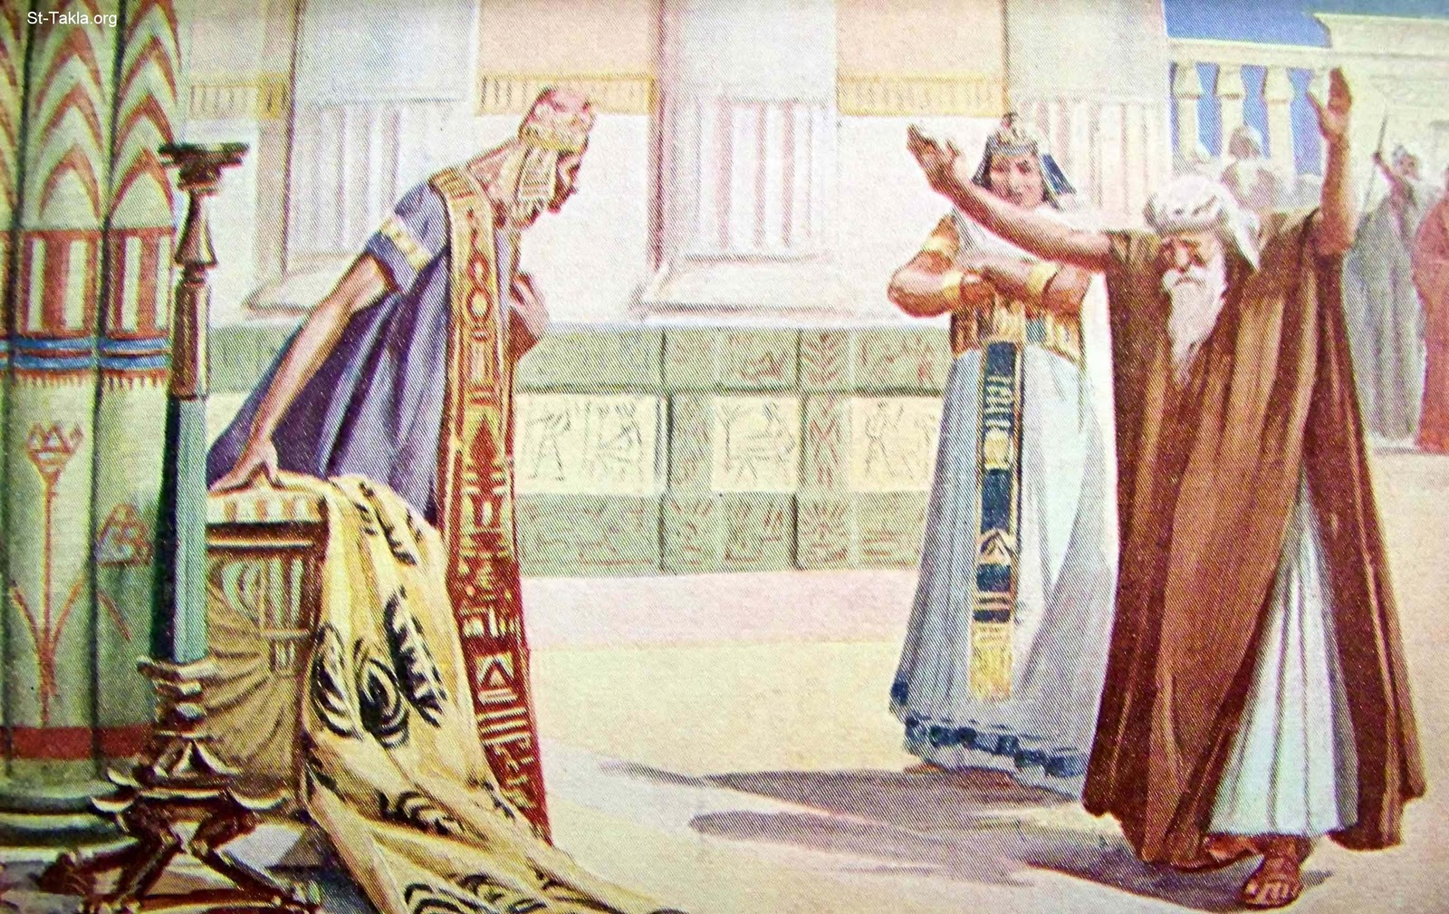

Slide 18
Genesis 12:2
I will make you a great nation; I will bless you And make your name great; And you shall be a blessing.

Slide 19
Genesis 12:3
I will bless those who bless you, And I will curse him who curses you; And in you all the families of the earth shall be blessed."

Slide 20
Genesis 41:55
So when all the land of Egypt was famished, the people cried to Pharaoh for bread. Then Pharaoh said to all the Egyptians, "Go to Joseph; whatever he says to you, do."

Slide 21
Joseph Took Control of their Money

Slide 22
Genesis 47:13
Now there was no bread in all the land; for the famine was very severe, so that the land of Egypt and the land of Canaan languished because of the famine.

Slide 23
Genesis 47:14
And Joseph gathered up all the money that was found in the land of Egypt and in the land of Canaan, for the grain which they bought; and Joseph brought the money into Pharaoh's house.

Slide 24
Joseph Took Control over their Possessions

Slide 25
Genesis 47:15
So when the money failed in the land of Egypt and in the land of Canaan, all the Egyptians came to Joseph and said, "Give us bread, for why should we die in your presence? For the money has failed."

Slide 26
Genesis 47:16
Then Joseph said, "Give your livestock, and I will give you bread for your livestock, if the money is gone."

Slide 27
Genesis 47:17a
So they brought their livestock to Joseph, and Joseph gave them bread in exchange for the horses, the flocks, the cattle of the herds, and for the donkeys.

Slide 28
Genesis 47:17b
Thus he fed them with bread in exchange for all their livestock that year.

Slide 29
Joseph Took Control of their Property

Slide 30
Genesis 47:18a
When that year had ended, they came to him the next year and said to him, "We will not hide from my lord that our money is gone; my lord also has our herds of livestock.

Slide 31
Genesis 47:18b
There is nothing left in the sight of my lord but our bodies and our lands.

Slide 32
Genesis 47:19a
Why should we die before your eyes, both we and our land? Buy us and our land for bread, and we and our land will be servants of Pharaoh;

Slide 33
Genesis 47:19b
give us seed, that we may live and not die, that the land may not be desolate."

Slide 34
Genesis 47:20
Then Joseph bought all the land of Egypt for Pharaoh; for every man of the Egyptians sold his field, because the famine was severe upon them. So the land became Pharaoh's.

Slide 35
James 1:17
Every good gift and every perfect gift is from above, and comes down from the Father of lights, with whom there is no variation or shadow of turning.

Slide 36
Joseph Took Control of their Persons and Positions

Slide 37
Genesis 47:21
And as for the people, he moved them into the cities, from one end of the borders of Egypt to the other end.

Slide 38
Romans 12:1
I beseech you therefore, brethren, by the mercies of God, that you present your bodies a living sacrifice, holy, acceptable to God, which is your reasonable service.

Slide 39
Romans 12:2
And do not be conformed to this world, but be transformed by the renewing of your mind, that you may prove what is that good and acceptable and perfect will of God.

Slide 40
Joseph Took Control of their Production

Slide 41
Genesis 47:22
Only the land of the priests he did not buy; for the priests had rations allotted to them by Pharaoh, and they ate their rations which Pharaoh gave them; therefore they did not sell their lands.

Slide 42
Genesis 47:23
Then Joseph said to the people, "Indeed I have bought you and your land this day for Pharaoh. Look, here is seed for you, and you shall sow the land.

Slide 43
Genesis 47:24
And it shall come to pass in the harvest that you shall give one-fifth to Pharaoh. Four-fifths shall be your own, as seed for the field and for your food, for those of your households and as food for your little ones."

Slide 44
Genesis 47:25
So they said, "You have saved our lives; let us find favor in the sight of my lord, and we will be Pharaoh's servants."

Slide 45
Genesis 47:26
And Joseph made it a law over the land of Egypt to this day, that Pharaoh should have one-fifth, except for the land of the priests only, which did not become Pharaoh's.

Slide 46
Matthew 7:24
"Therefore whoever hears these sayings of Mine, and does them, I will liken him to a wise man who built his house on the rock:

Slide 47
Matthew 7:25
and the rain descended, the floods came, and the winds blew and beat on that house; and it did not fall, for it was founded on the rock.

Slide 48
Matthew 7:26
But everyone who hears these sayings of Mine, and does not do them, will be like a foolish man who built his house on the sand:

Slide 49
Matthew 7:27
and the rain descended, the floods came, and the winds blew and beat on that house; and it fell. And great was its fall."

Slide 50
Genesis 47:27
So Israel dwelt in the land of Egypt, in the country of Goshen; and they had possessions there and grew and multiplied exceedingly.

Slide 51
Genesis 47:28
And Jacob lived in the land of Egypt seventeen years. So the length of Jacob's life was one hundred and forty-seven years.

Slide 52
Genesis 47:29a
When the time drew near that Israel must die, he called his son Joseph and said to him, "Now if I have found favor in your sight,

Slide 53
Genesis 47:29b
please put your hand under my thigh, and deal kindly and truly with me. Please do not bury me in Egypt,

Slide 54
Genesis 47:30
but let me lie with my fathers; you shall carry me out of Egypt and bury me in their burial place." And he said, "I will do as you have said."

Slide 55
Genesis 47:31
Then he said, "Swear to me." And he swore to him. So Israel bowed himself on the head of the bed.

Slide 56
Joel 2:25
So I will restore to you the years that the swarming locust has eaten, The crawling locust, The consuming locust, And the chewing locust, My great army which I sent among you.

