Slide 1
Raising up Zion Before the Nations
www.blessisraelnetwork.com

Slide 2
1948- A Genuine Miracle

Slide 3
Set Apart as a Unique Treasure
The only nation ever….to be reborn
The only language ever….to be resurrected
The only people ever….to reappear
All in their original location
www.blessisraelnetwork.com

Slide 4
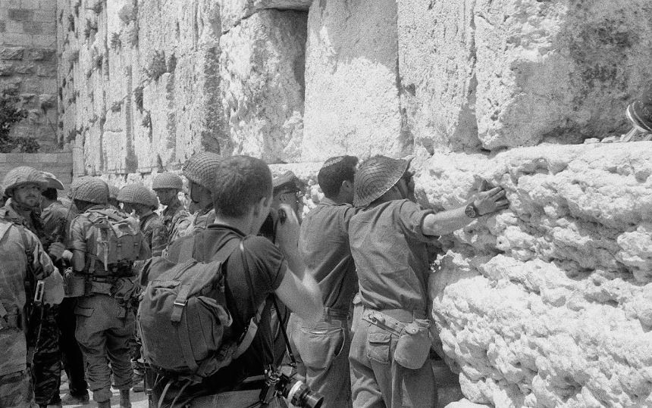
1967- Another Miracle
Jerusalem reunited for the first time
since the Roman occupation
www.blessisraelnetwork.com

Slide 5
In the home stretch of the ‘Last Days’
Since Jerusalem was reunited:
Jesus movement began
Worldwide Messianic movement exploded
Rise of Christian Zionism
Spread of fundamental Islam
Economic meltdown
One world order
Nations turning against Israel
175 Messianic congregations now in Israel!!
www.blessisraelnetwork.com

Slide 6
What is Bless ISRAEL Network?
Bless ISRAEL Network is a media organization from Israel.
We are about to CHANGE the landscape of TV ministry in Israel with our first program:
www.blessisraelnetwork.com

Slide 7
What does the program include?
Hosted by Israeli believers
Daniel and Devorah Calic
Teachings
Interviews
Interesting material about the land and people of Israel
www.blessisraelnetwork.com

Slide 8
Do you know….
The vast majority of Christian ministries and pastors who visit Israel connect only with pre-believing traditional Jewish groups and organizations, and bypass the Jewish believers (the household of faith).
The government welcomes Christians who stand with Israel, as long as said Christians are not blessing the believing Jews.
We believe time has come for believers around the world to connect with their brethren believers in Israel and bless them!

Slide 9
What makes our ministry unique?
The first program based in Israel to provide a much-needed platform for Jewish believers in the Land to have a voice out to the nations.
An opportunity for believers in the nations to see how the Kingdom is being built one living stone at a time in Israel.
Establish direct connection between Jewish believers in Israel and believers in the rest of the world. [‘One New Man’]
The ability to bless the household of faith in Israel
Jewish believers can use the blessing for local outreach, which includes spreading the Good News to their Jewish brethren
Thus, believers around the world can have a direct impact on building the Kingdom in Israel!
Genesis 12:3 “I will bless those who bless you”
www.blessisraelnetwork.com

Slide 10
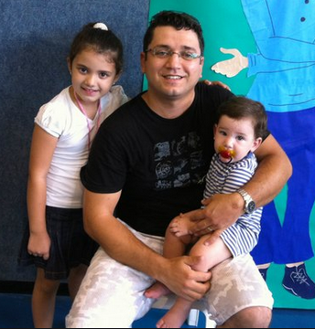
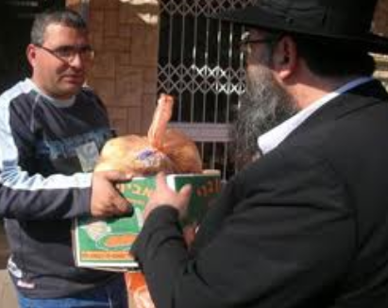
Who will be on the program?
Jewish believers from throughout Israel
Selected visiting leaders from the nations
Leaders of Israeli Messianic Congregations
For example:
Pastor from Light of the Galilee 600 meals per month handed out
www.blessisraelnetwork.com

Slide 11
Media
Like us on Facebook:
www.facebook.om/BlessIsraelNetwork

Slide 12
What can you do?
Donate to Bless ISRAEL Network
Partner with us as a sponsor or investor
Invite us to speak
Speak to your leadership about “BiN”
Spread the word
Pray! Pray! Pray!
www.blessisraelnetwork.com

Slide 13
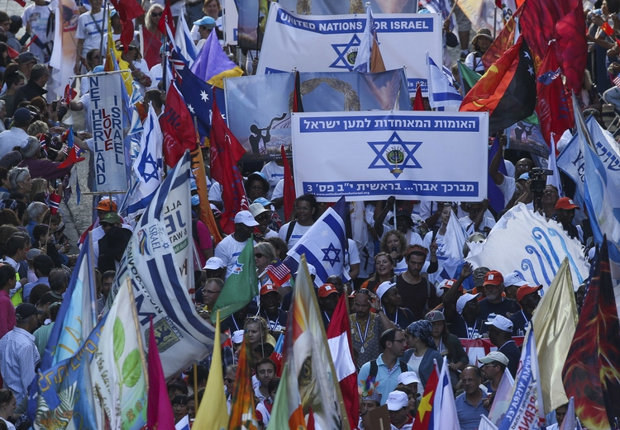
Hispanic Support for Israel
www.blessisraelnetwork.com

Slide 14
Contact
www.blessisraelnetwork.com

