Slide 1
Are You a Face in the Crowd?
Matthew 27:32-56
Good Friday Service, 29 March 2013
Calvary Chapel of El Paso

Slide 2
Matthew 27:32-56

Slide 3
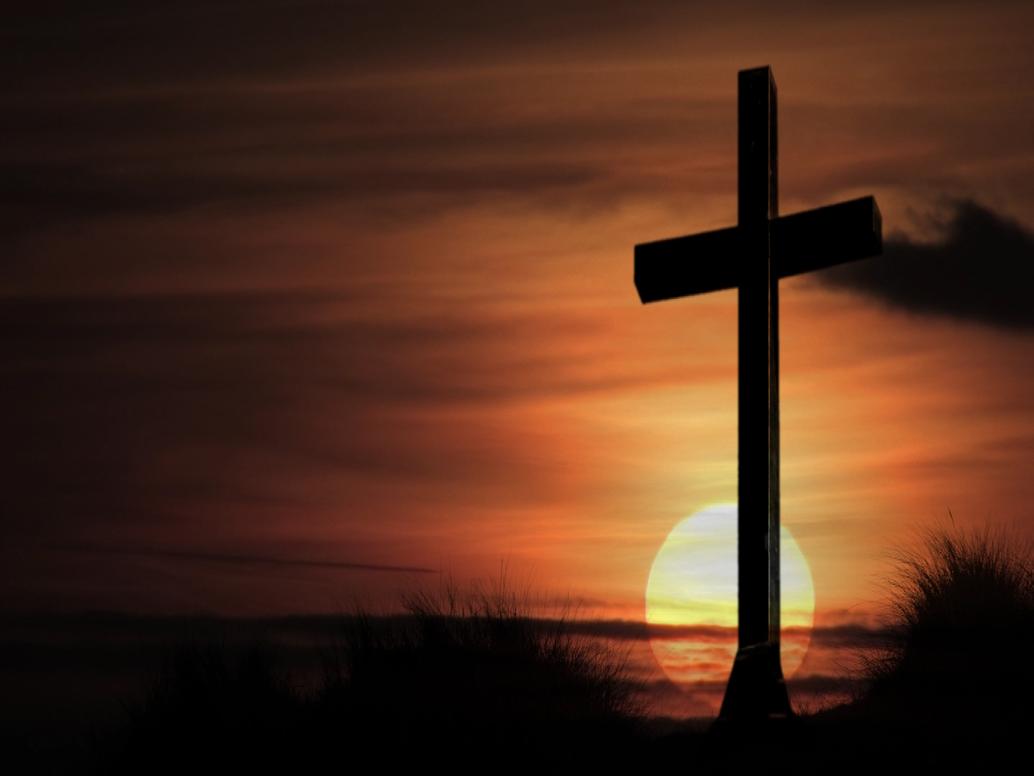

Slide 4
At The Cross
At the Cross, at the Cross
Where I first saw the light
And the burden of my heart rolled away;
It was there by faith I received my sight,
And now I am happy all the day!

Slide 5
The Old Rugged Cross
On a hill far away,
Stood an old rugged cross,
The emblem of suffering and shame;
And I love that old cross,
Where the dearest and best
For a world of lost sinners was slain.

Slide 6
The Old Rugged Cross
So I’ll cherish the old rugged cross,
Till my trophies at last I lay down.
I will cling to the old rugged cross,
And exchange it someday for a crown.

Slide 7
But even resurrection has to begin with the Cross!

Slide 8
Matthew 27:27-32
³² Now as they came out, they found a man of Cyrene, Simon by name. Him they compelled to bear His cross.

Slide 9
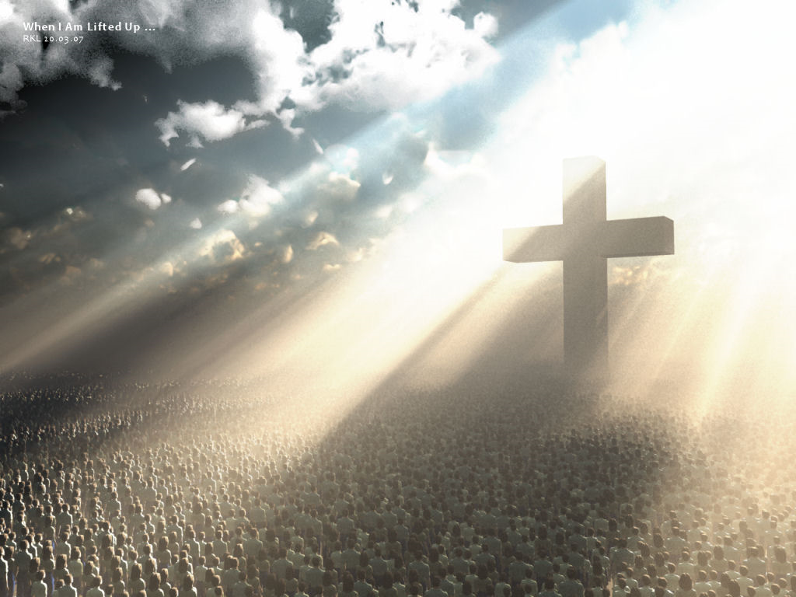

Slide 10
The First Snapshot: The One Forced to the Cross

Slide 11
You can be close to the Cross and yet be far from Christ!

Slide 12
John 12:31-33
³¹ Now is the judgment of this world: now shall the prince of this world be cast out. ³² And I, if I be lifted up from the earth, will draw all men unto me. ³³ This he said, signifying what death he should die.

Slide 13
The Second Snapshot: The Foolish at the Cross

Slide 14
Matthew 27:38-44

Slide 15
Close to the Cross but far from the Blood!

Slide 16
1 Corinthians 1:18
For the message of the cross is foolishness to those who are perishing, but to us who are being saved it is the power of God.

Slide 17
1 Corinthians 1:25
Because the foolishness of God is wiser than men, and the weakness of God is stronger than men.

Slide 18
The Third Snapshot: Those Forgiven Through the Cross!

Slide 19
Matthew 27:45-56

Slide 20
John 1:11-13
¹¹ He came to His own, and His own did not receive Him. ¹² But as many as received Him, to them He gave the right to become children of God, to those who believe in His name: ¹³ who were born, not of blood, nor of the will of the flesh, nor of the will of man, but of God.

Slide 21
Romans 1:16-17
¹⁶ For I am not ashamed of the gospel of Christ, for it is the power of God to salvation for everyone who believes, for the Jew first and also for the Greek. ¹⁷ For in it the righteousness of God is revealed from faith to faith; as it is written, "The just shall live by faith."

Slide 22
Ephesians 2:4-5
⁴ But God, who is rich in mercy, because of His great love with which He loved us, ⁵ even when we were dead in trespasses, made us alive together with Christ (by grace you have been saved),

Slide 23
Romans 6:23
²³ For the wages of sin is death, but the gift of God is eternal life in Christ Jesus our Lord.

Slide 24
Are you a face in the crowd before the Cross of Jesus Christ?

