Slide 1
A Quick Prophecy Update
The Distinction between ISIS and ISIL

Slide 2
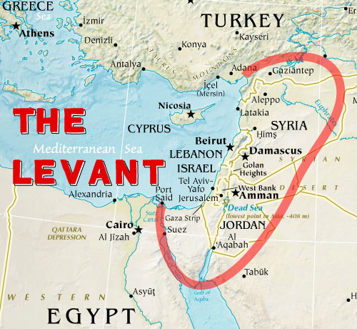

Slide 3
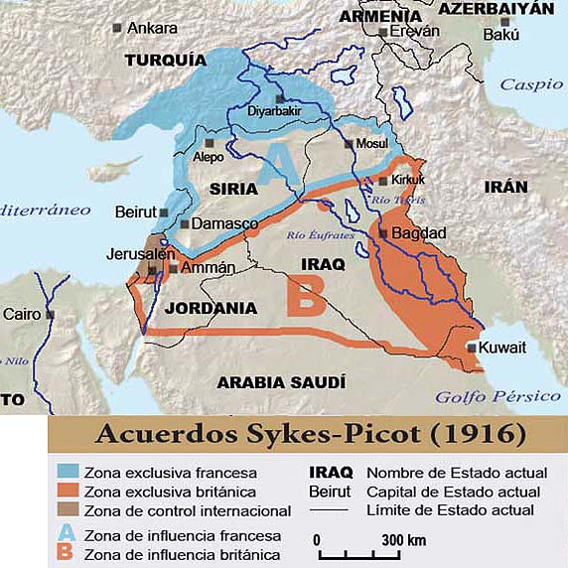

Slide 4
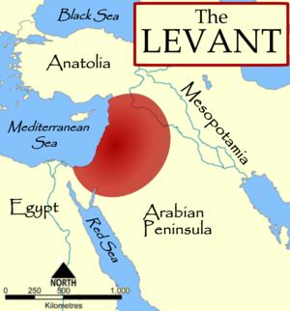

Slide 5
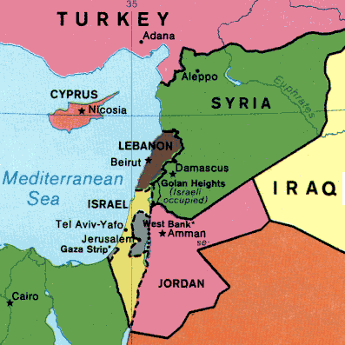

Slide 6
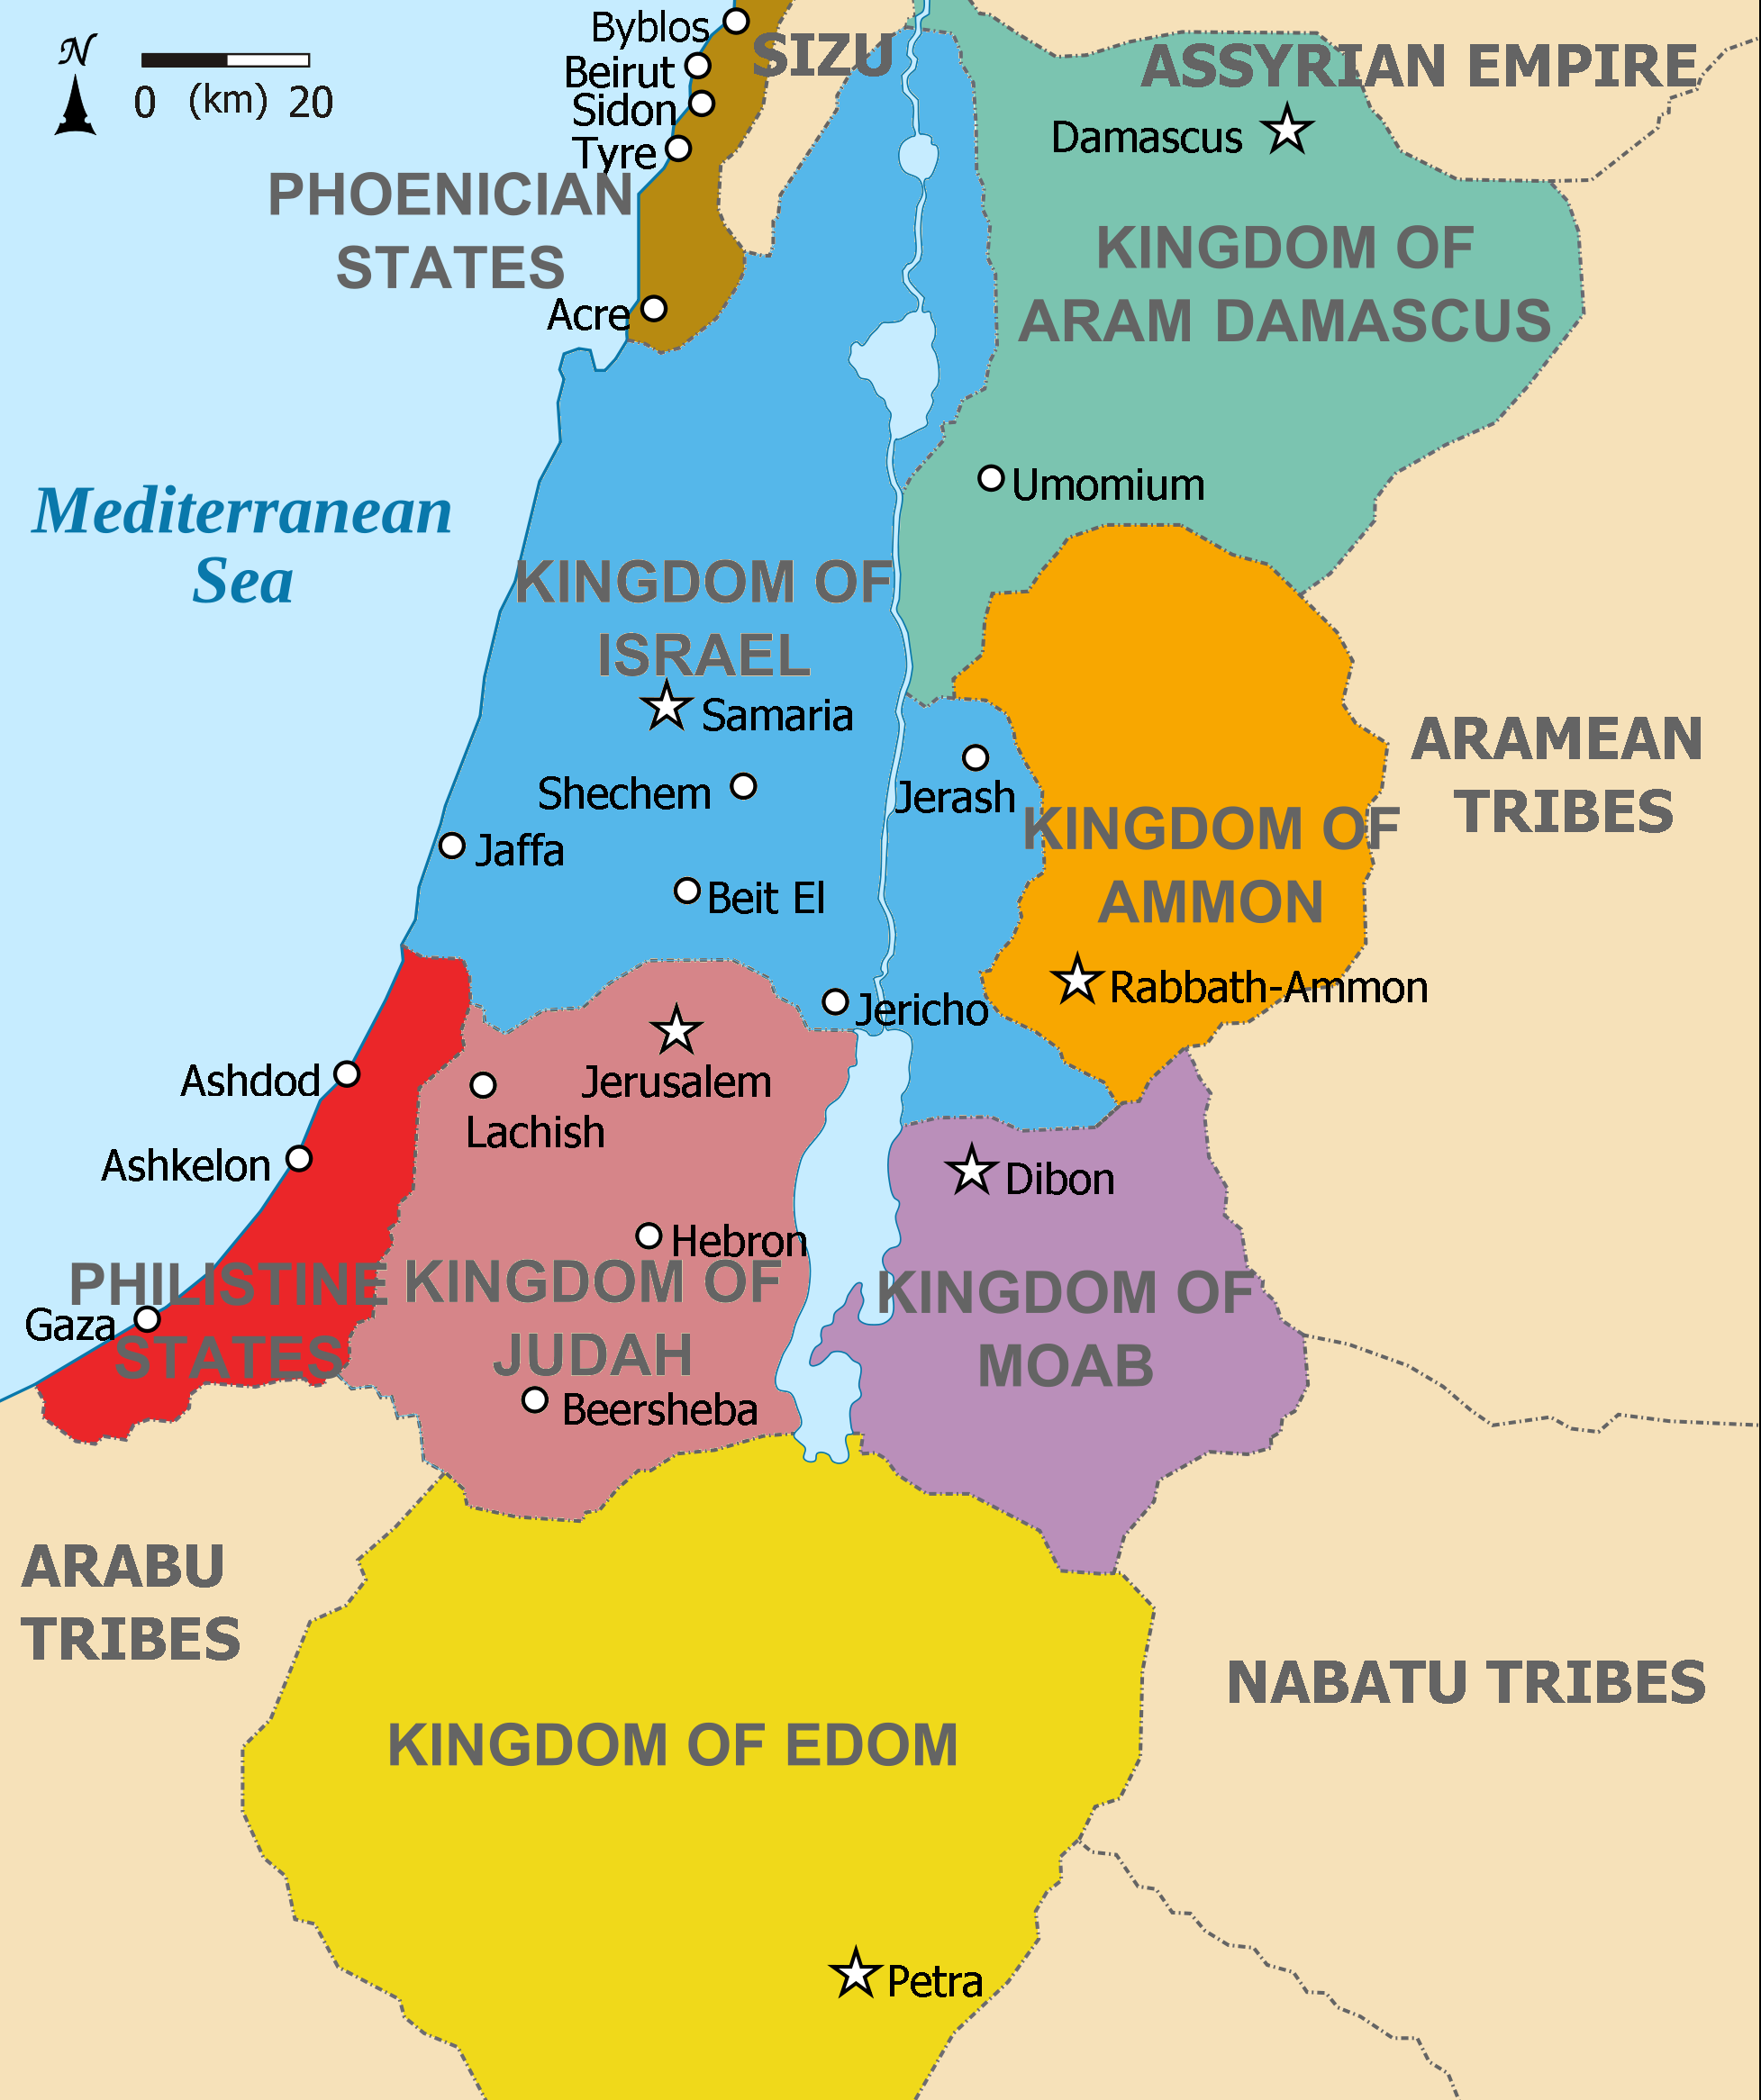

Slide 7
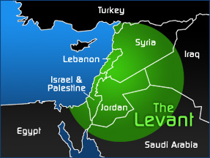

Slide 8
ISIS or ISIL
Al-Dawla Al-Islamiya fi al-Iraq wa al-Sham

