Slide 1
A Lesson on Birthright
Genesis 25:27-34
March 2-3, 2013
Calvary Chapel of El Paso

Slide 2
Genesis 25:27-34
²⁷ So the boys grew. And Esau was a skillful hunter, a man of the field; but Jacob was a mild man, dwelling in tents.

Slide 3
Genesis 25:27-34
²⁸ And Isaac loved Esau because he ate of his game, but Rebekah loved Jacob.

Slide 4
Genesis 25:27-34
²⁹ Now Jacob cooked a stew; and Esau came in from the field, and he was weary.

Slide 5
Genesis 25:27-34
³⁰ And Esau said to Jacob, "Please feed me with that same red stew, for I am weary." Therefore his name was called Edom.

Slide 6
Genesis 25:27-34
³¹ But Jacob said, "Sell me your birthright as of this day."

Slide 7
Genesis 25:27-34
³² And Esau said, "Look, I am about to die; so what is this birthright to me?"

Slide 8
Genesis 25:27-34
³³ Then Jacob said, "Swear to me as of this day." So he swore to him, and sold his birthright to Jacob.

Slide 9
Genesis 25:27-34
³⁴ And Jacob gave Esau bread and stew of lentils; then he ate and drank, arose, and went his way. Thus Esau despised his birthright.

Slide 10
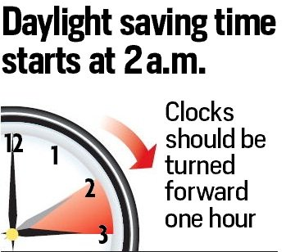
NEXT SUNDAY:

Slide 11
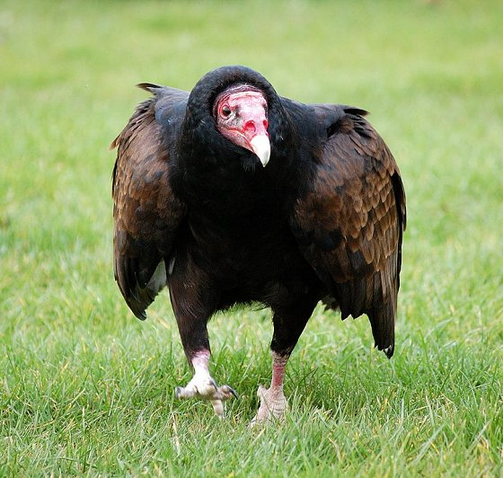
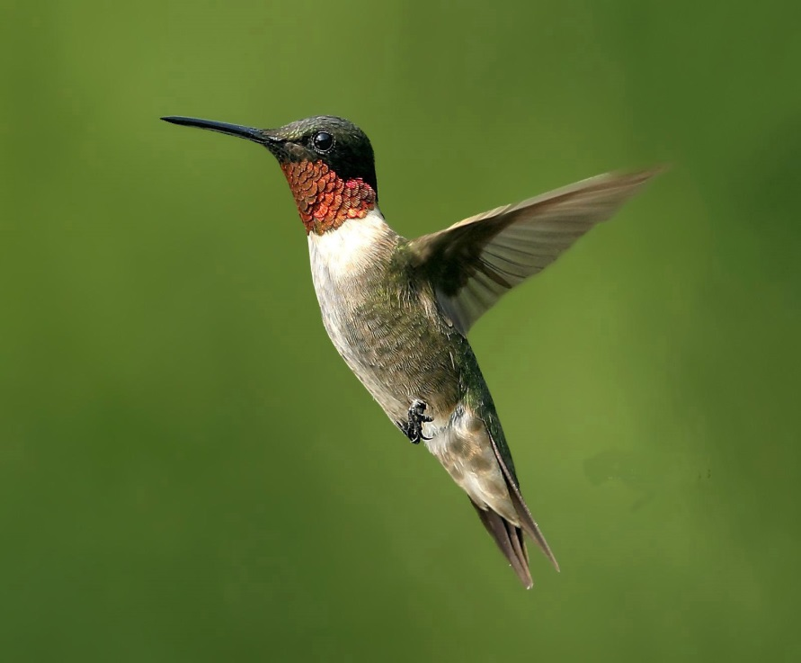

Slide 12
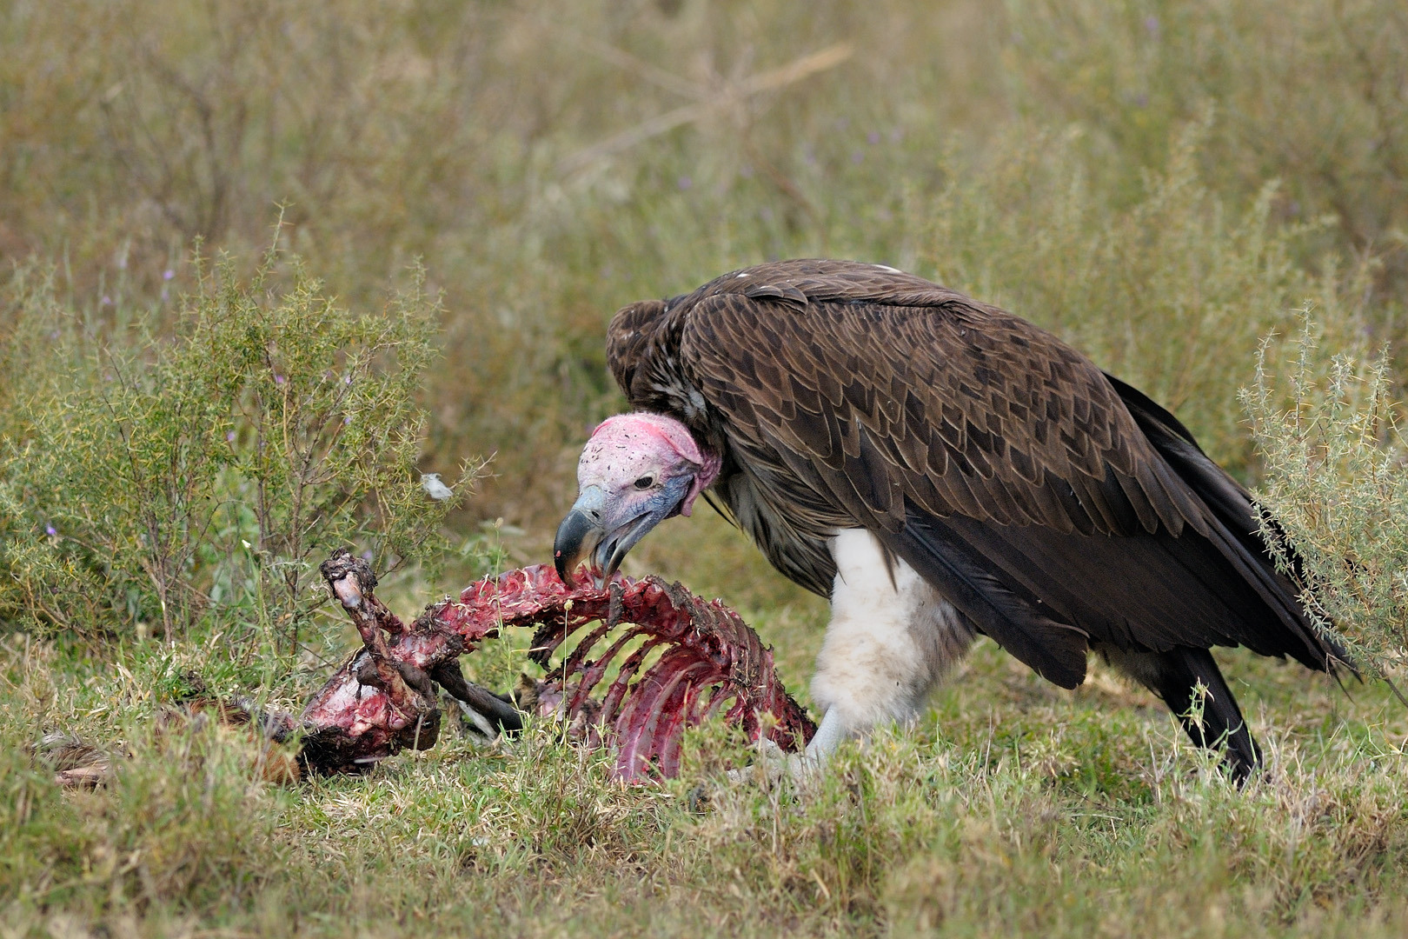

Slide 14
Proverbs 22:3-4
³ A prudent man foresees evil and hides himself, But the simple pass on and are punished. ⁴ By humility and the fear of the LORD Are riches and honor and life.

Slide 15
1 Corinthians 10:13
No temptation has overtaken you except such as is common to man; but God is faithful, who will not allow you to be tempted beyond what you are able, but with the temptation will also make the way of escape, that you may be able to bear it.

Slide 16
Genesis 25:27
So the boys grew. And Esau was a skillful hunter, a man of the field; but Jacob was a mild man, dwelling in tents.

Slide 17
Romans 6:6
knowing this, that our old man was crucified with Him, that the body of sin might be done away with, that we should no longer be slaves of sin.

Slide 18
Genesis 25:28
And Isaac loved Esau because he ate of his game, but Rebekah loved Jacob.

Slide 19
Romans 14:17
for the kingdom of God is not eating and drinking, but righteousness and peace and joy in the Holy Spirit.

Slide 20
John 21:15
So when they had eaten breakfast, Jesus said to Simon Peter, "Simon, son of Jonah, do you love Me more than these?" He said to Him, "Yes, Lord; You know that I love You." He said to him, "Feed My lambs."

Slide 21
Two Different Sets of Values
Esau Minded Earthly Things
Jacob Minded Eternal Things

Slide 22
Genesis 25:29-34

Slide 23
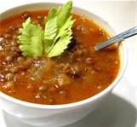
A Lesson on Birthright

Slide 24
1 Corinthians 2:14
But the natural man does not receive the things of the Spirit of God, for they are foolishness to him; nor can he know them, because they are spiritually discerned.

Slide 25
A Lesson on Birthright
A Physical Blessing
A Spiritual Blessing

Slide 26
Deuteronomy 21:17
But he shall acknowledge the son of the unloved wife as the firstborn by giving him a double portion of all that he has, for he is the beginning of his strength; the right of the firstborn is his.

Slide 27
1 Chronicles 5:1-2
¹ Now the sons of Reuben the firstborn of Israel—he was indeed the firstborn, but because he defiled his father's bed, his birthright was given to the sons of Joseph, the son of Israel, so that the genealogy is not listed according to the birthright; ² yet Judah prevailed over his brothers, and from him came a ruler, although the birthright was Joseph's—

Slide 28
What Esau Meant:
“I’m going to die anyway, so what good is a birthright to me?”

Slide 29
Hebrews 12:15-16
¹⁵ looking carefully lest anyone fall short of the grace of God; lest any root of bitterness springing up cause trouble, and by this many become defiled; ¹⁶ lest there be any fornicator or profane person like Esau, who for one morsel of food sold his birthright.

Slide 30
How Interesting:
Jacob was buying what was already his;
Esau was selling something that didn’t belong to him!

Slide 31
Donald Grey Barnhouse
“History shows that men prefer illusions to realities, choose time rather than eternity, and the pleasures of sin for a season rather than the joys of God forever. Men will read trash rather than the Word of God, and adhere to a system of priorities that leaves God out of their lives.

Slide 32
Donald Grey Barnhouse
“Multitudes of men spend more time shaving than on their souls; and multitudes of women give more minutes to their makeup than to the life of the eternal spirit. Men still sell their birthright for a mess of pottage.”

Slide 33
Ephesians 1:3-14
Are we making impulsive decisions or wise preparations?
Are we choosing the temporal over the eternal?

Slide 34
Let’s keep our eyes on eternity!
Let’s keep our eyes on JESUS!

