Slide 1
A Cradle, a Cross, A Crown
Philippians 2:5-11
December 20-21, 2014
Calvary Chapel of El Paso

Slide 2
Philippians 2:5
Let this mind be in you, which was also in Christ Jesus:

Slide 3
Philippians 2:6
Who, being in the form of God, thought it not robbery to be equal with God:

Slide 4
Philippians 2:7
But made himself of no reputation, and took upon him the form of a servant, and was made in the likeness of men:

Slide 5
Philippians 2:8
And being found in fashion as a man, he humbled himself, and became obedient unto death, even the death of the cross.

Slide 6
Philippians 2:9
Wherefore God also hath highly exalted him, and given him a name which is above every name:

Slide 7
Philippians 2:10
That at the name of Jesus every knee should bow, of things in heaven, and things in earth, and things under the earth;

Slide 8
Philippians 2:11
And that every tongue should confess that Jesus Christ is Lord, to the glory of God the Father.

Slide 10
John 1:1
In the beginning was the Word, and the Word was with God, and the Word was God.

Slide 11
John 1:10
He was in the world, and the world was made by him, and the world knew him not.

Slide 12
John 1:11
He came unto his own, and his own received him not.

Slide 13
John 1:12
But as many as received him, to them gave he power to become the sons of God, even to them that believe on his name:

Slide 14
John 1:13
Which were born, not of blood, nor of the will of the flesh, nor of the will of man, but of God.

Slide 15
John 1:14
And the Word was made flesh, and dwelt among us, (and we beheld his glory, the glory as of the only begotten of the Father,) full of grace and truth.

Slide 16
Philippians 2:5
Let this mind be in you, which was also in Christ Jesus:

Slide 17
Philippians 2:6
Who, being in the form of God, thought it not robbery to be equal with God:

Slide 18
Philippians 2:7
But made himself of no reputation, and took upon him the form of a servant, and was made in the likeness of men:

Slide 19
1 Corinthians 15:1
Moreover, brethren, I declare unto you the gospel which I preached unto you, which also ye have received, and wherein ye stand;

Slide 20
1 Corinthians 15:2
By which also ye are saved, if ye keep in memory what I preached unto you, unless ye have believed in vain.

Slide 21
1 Corinthians 15:3
For I delivered unto you first of all that which I also received, how that Christ died for our sins according to the scriptures;

Slide 22
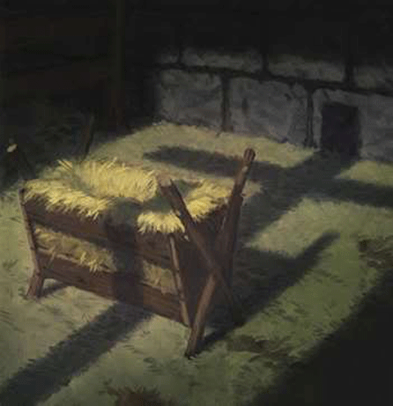

Slide 23
Philippians 2:8
And being found in fashion as a man, he humbled himself, and became obedient unto death, even the death of the cross.

Slide 24
Deuteronomy 21:23a
His body shall not remain all night upon the tree, but thou shalt in any wise bury him that day; (for he that is hanged is accursed of God;)

Slide 25
Deuteronomy 21:23b
that thy land be not defiled, which the LORD thy God giveth thee for an inheritance.

Slide 26
Galatians 3:13
Christ hath redeemed us from the curse of the law, being made a curse for us: for it is written, Cursed is every one that hangeth on a tree:

Slide 27
Hebrews 12:2
Looking unto Jesus the author and finisher of our faith; who for the joy that was set before him endured the cross, despising the shame, and is set down at the right hand of the throne of God.

Slide 28
Philippians 2:9
Wherefore God also hath highly exalted him, and given him a name which is above every name:

Slide 29
Philippians 2:10
That at the name of Jesus every knee should bow, of things in heaven, and things in earth, and things under the earth;

Slide 30
Philippians 2:11
And that every tongue should confess that Jesus Christ is Lord, to the glory of God the Father.

Slide 31
Romans 14:9
For to this end Christ both died, and rose, and revived, that he might be Lord both of the dead and living.

Slide 32
Romans 14:10
But why dost thou judge thy brother? or why dost thou set at nought thy brother? for we shall all stand before the judgment seat of Christ.

Slide 33
Romans 14:11
For it is written, As I live, saith the Lord, every knee shall bow to me, and every tongue shall confess to God.

Slide 34
Romans 14:12
So then every one of us shall give account of himself to God.

Slide 35
Romans 14:13
Let us not therefore judge one another any more: but judge this rather, that no man put a stumblingblock or an occasion to fall in his brother's way.

